Slide 1
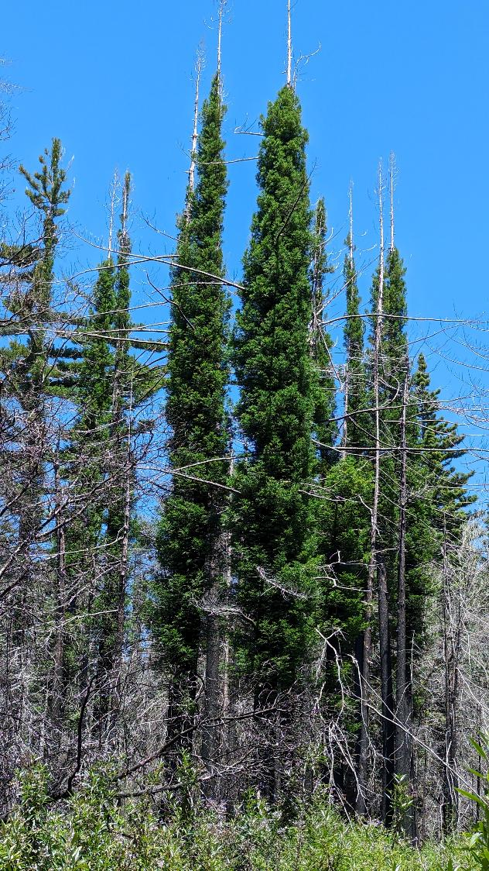
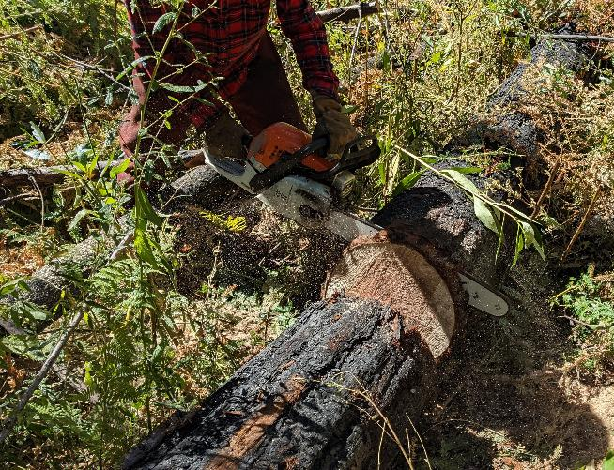
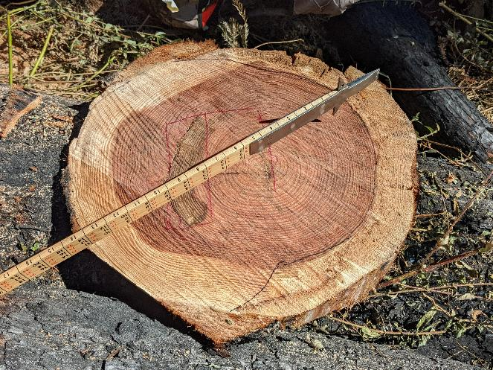
Santa Cruz Mountains
Coast Redwood
Defect Study
Nadia Hamey, Kristy Swor, Hamey Woods
Kristen Shive, UC Berkeley
Notes:
Hello Members of the EMC, We’re pleased to be here to present the Final Report for the Coast Redwood Defect Study, a project we started working on shortly after the 2020 CZU Lightning Complex Fire that has been funded by the EMC since 2022.
I’m Nadia Hamey, this is Kristy Swor a forester who works with me at Hamey Woods, and Kristen Shive, Assistant Professor of Cooperative Extension, UC Berkeley

Slide 2
What We’ll Cover
Why this study was needed
What we measured
What we found
How it became field guidance
What could come next
Notes:
Today we want to share: Why we embarked on this study, what we measured, what we found, how that informed our operations, and what could come next in terms of continuing this research…

Slide 3
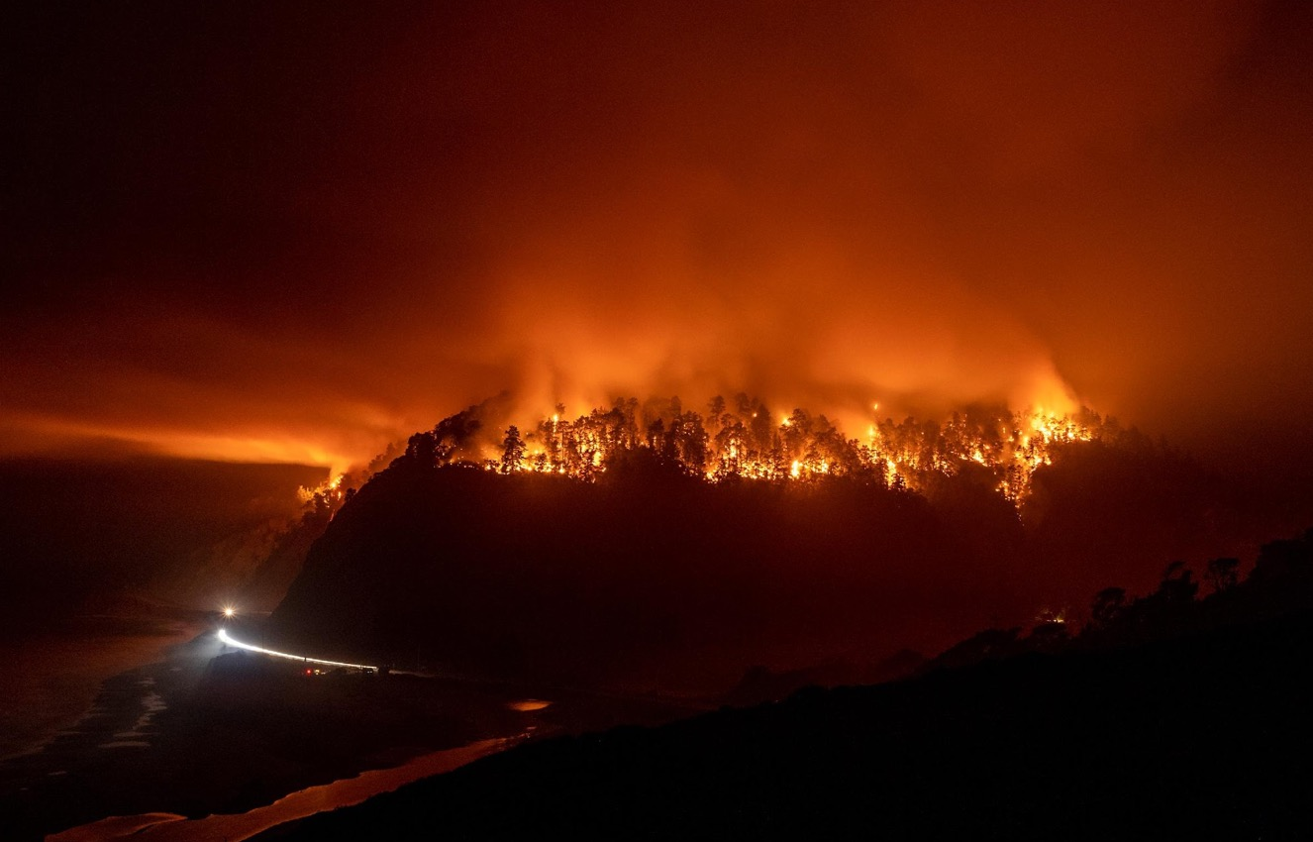
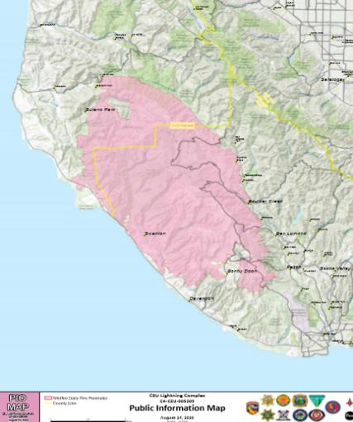
CZU Lightning Complex Fire
August 2020
11,000 lightning strikes in Santa Cruz Mountains became one massive fire
86,509 acres burned
911 homes destroyed
Santa Cruz
Notes:
The CZU fire, which started in August 2020 when approximately 11,000 lightning strikes hit the Santa Cruz Mountains, was fanned by prevailing winds, and many small fires formed one massive, high-severity fire that blew up 40,000 acres in one day.

Slide 4
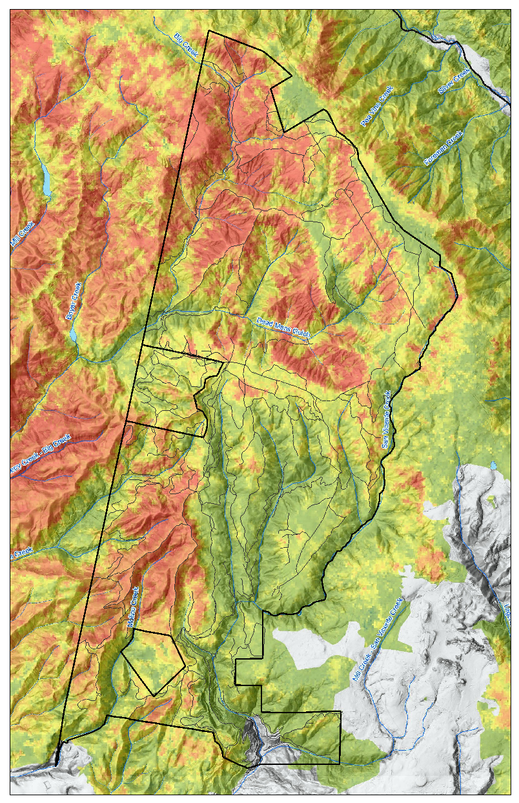
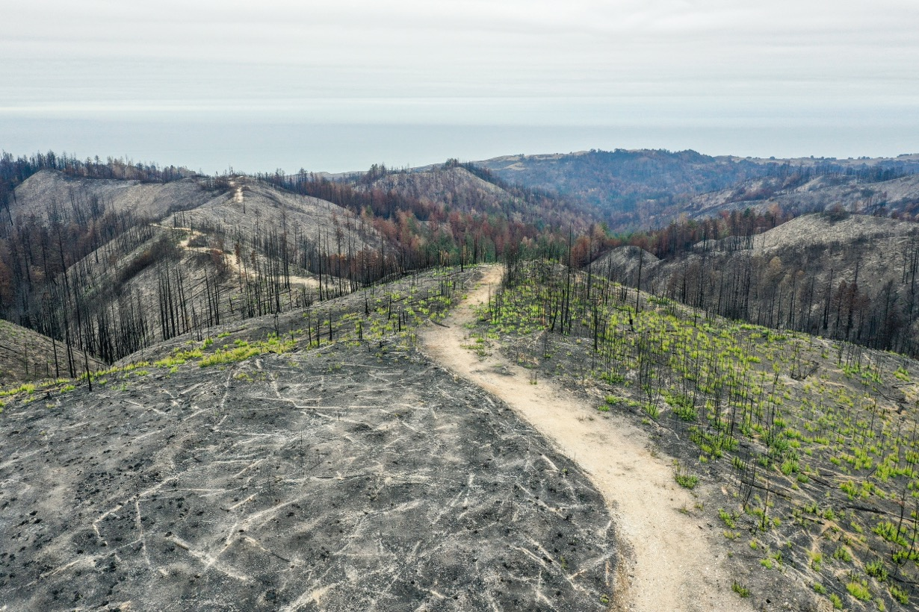
POST-FIRE CONDITIONS ON THE GROUND
November 2020 (2 months post-fire)
Notes:
Approximately 40% of forested acres within the CZU footprint burned at high severity, 43% of the footprint burned at moderate to high severity, 57% at low severity.
This is a map and picture of the San Vicente Redwoods property, where the Board toured last month, and we collected the data for this study.

Slide 5
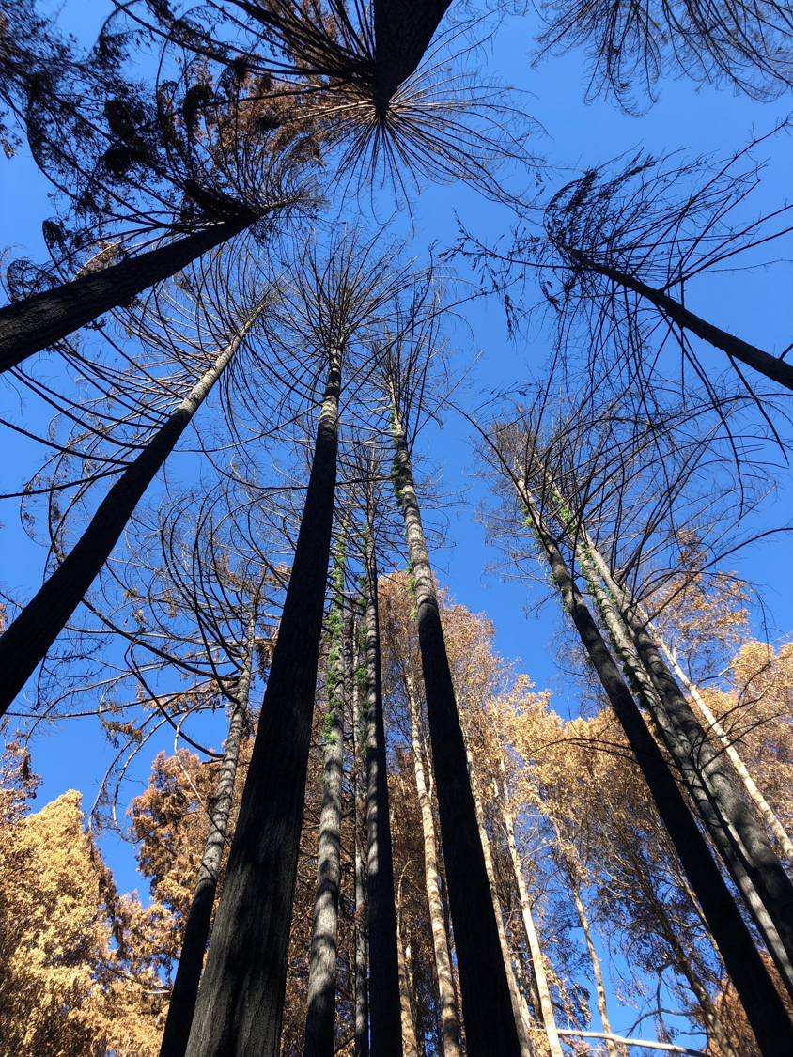
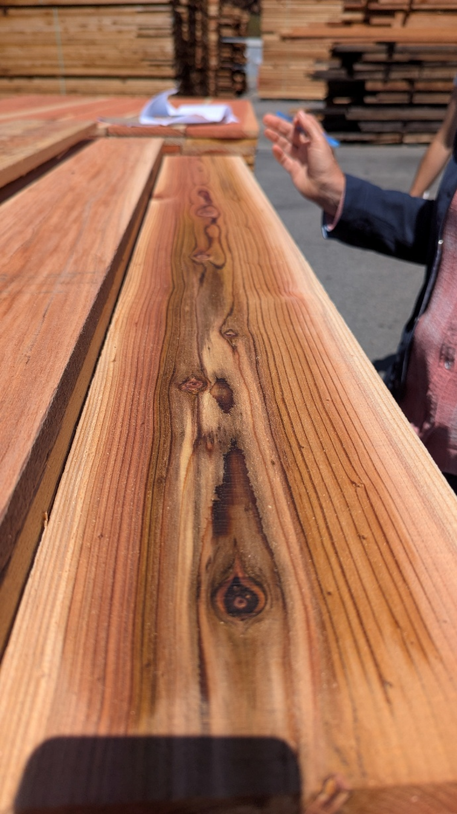
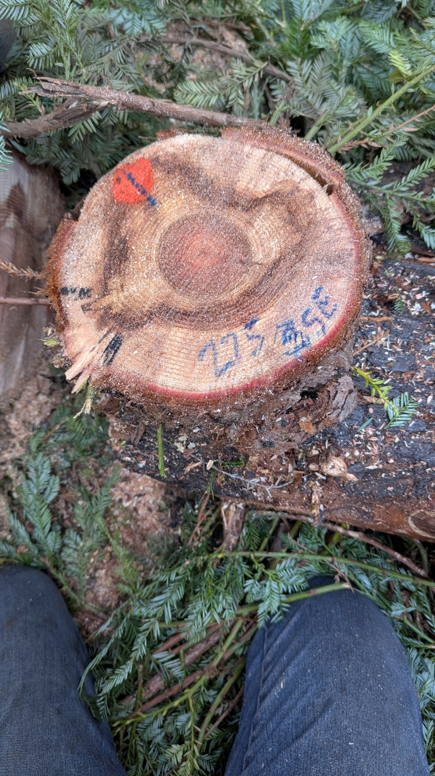
Notes:
Coast redwood forests present a unique post-fire management challenge because the trees may survive biologically, but their future merchantability may be compromised. For timberland owners and foresters, this creates a difficult decision window when timely evaluation of post-fire conditions is needed.
In coast redwood stands, managers must often make these decisions before the full extent of delayed mortality, decay development, and merchantability loss is known.

Slide 6
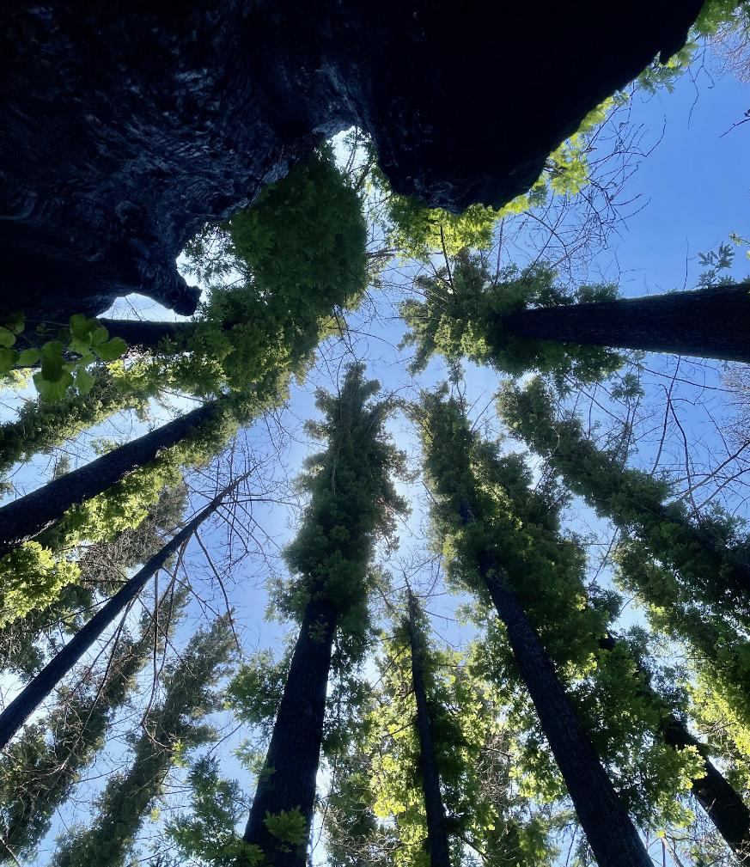
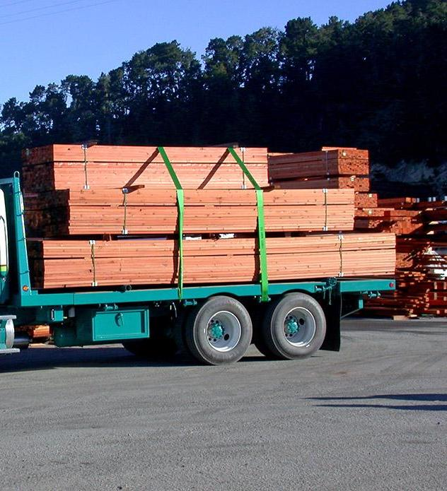
Big Creek Lumber
Notes:
The primary goal of the study was to increase the understanding of decay in redwoods as a result of varying degrees of burn damage. We wanted to see whether we could predict defect from post-fire visual indicators. Identifying which trees have the highest likelihood of defect could help redwood timberland managers make the most appropriate, timely decisions about which trees to harvest.

Slide 7
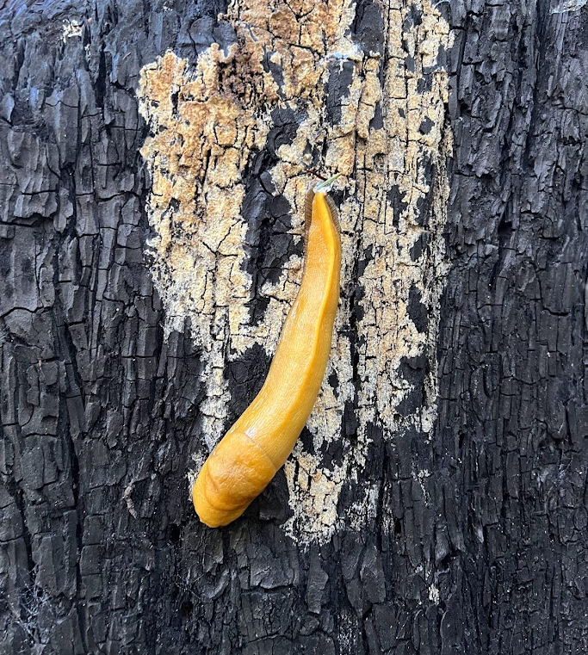
Coniophora puteana, ‘wet rot’
Brown wet rot at base of stem
Needs high water content (50-60%)
Signs: No external indicators unless host is injured
  Brown–black Mycelial cords
  Cream–brown center bounded by white margins
Notes:
Early on we identified Coniophora puteana, a naturally occurring wood-decaying fungus, on the bark of some trees. The Coniophora fungus causes brown wet rot at the base of the stem and often the roots
There are rarely external indicators on the tree but if a host is wounded you might see fungus with a cream to brown center bounded by white margins
The affected wood first becomes discolored and soft and eventually drys and cracks
This is a cause of concern in sustainable forestry as the wood becomes unmerchantable.

Slide 8
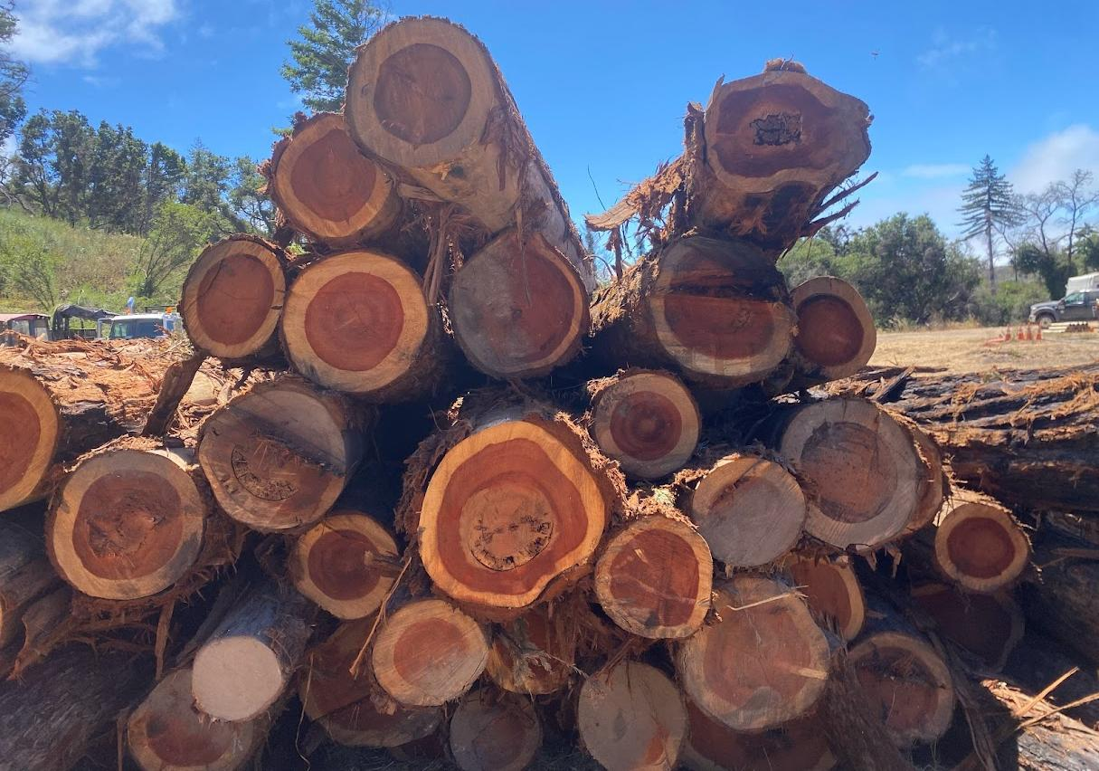
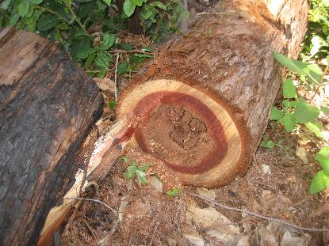
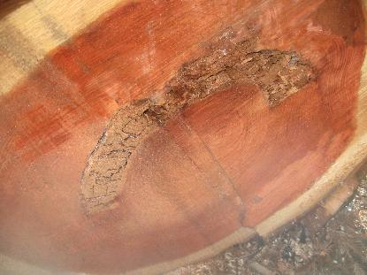
Notes:
This deck shows some logs impacted by the 2020 fire (yellow) and some logs impcted by the 1948 fire (red arrow). I’ve worked most of my career in areas impacted by the 1948 Pine Mountain Fire and seen the residual decay from that event in the core of trees.
Some of the trees
compartmentalized the rot (like the trees on lower left), while others
eventually had everything that grew prior to 1948 subsumed by rot (upper left).
We seek to understand how the 2020 fire has affected and will continue to affect merchantability and whether we can tell by looking at the trees.

Slide 9
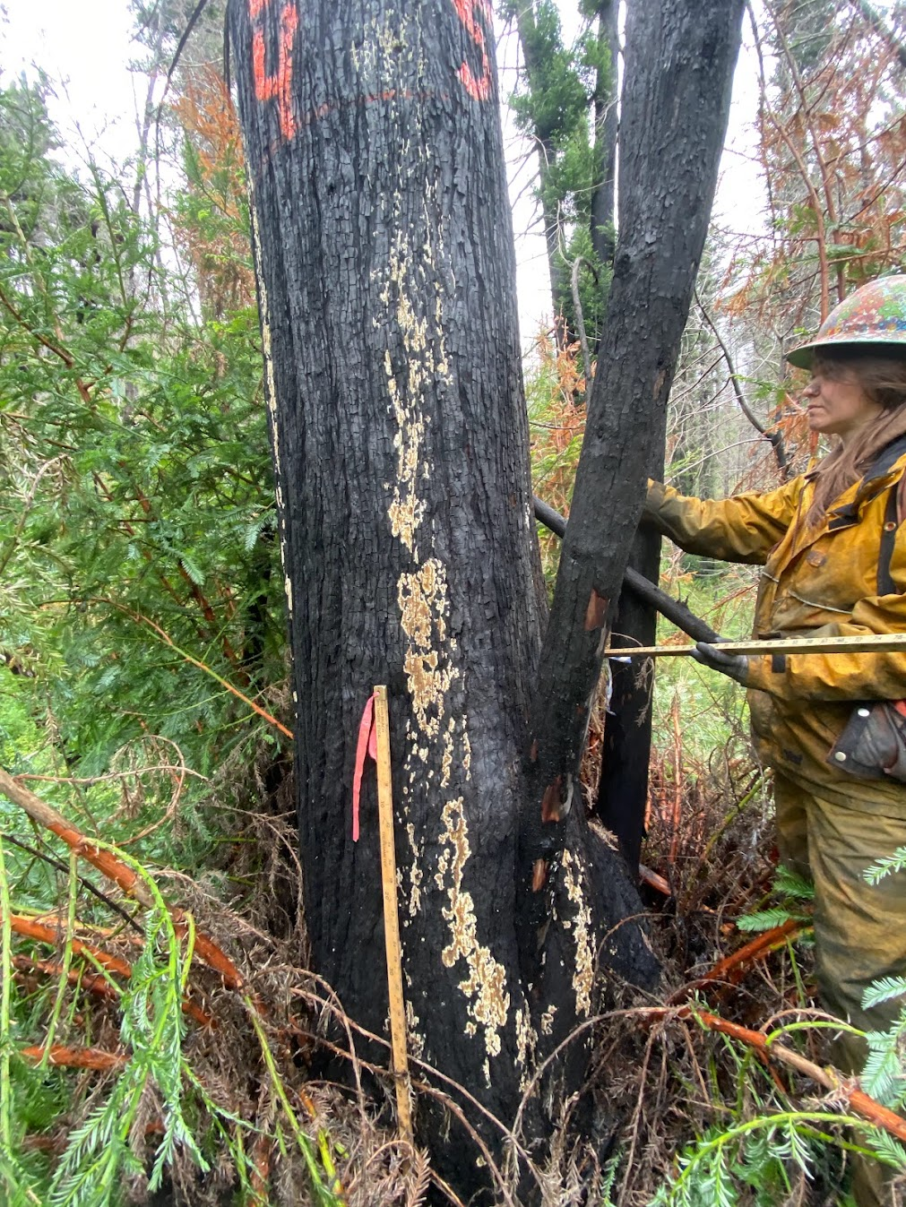
Research questions
How frequently did defect occur, and how much was observed for a given tree?
Can we predict the presence of defect in burned coast redwood trees by using external indicators of fire injury, response and tree characteristics?
Where defect is present, can we predict how much will occur, using the same external indicators?

Slide 10
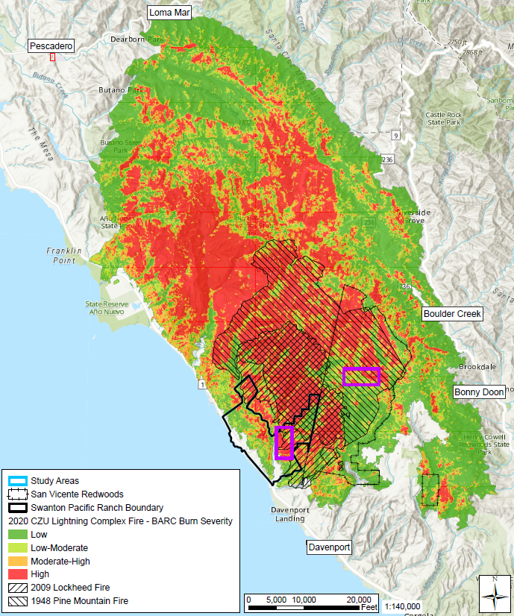

Study Area
Cal Poly’s Swanton Pacific Ranch
San Vicente Redwoods
Notes:
The study area is at two properties burned with a mosaic of burn severities.
Cal Poly’s Swanton Pacific Ranch
San Vicente Redwoods

Slide 11
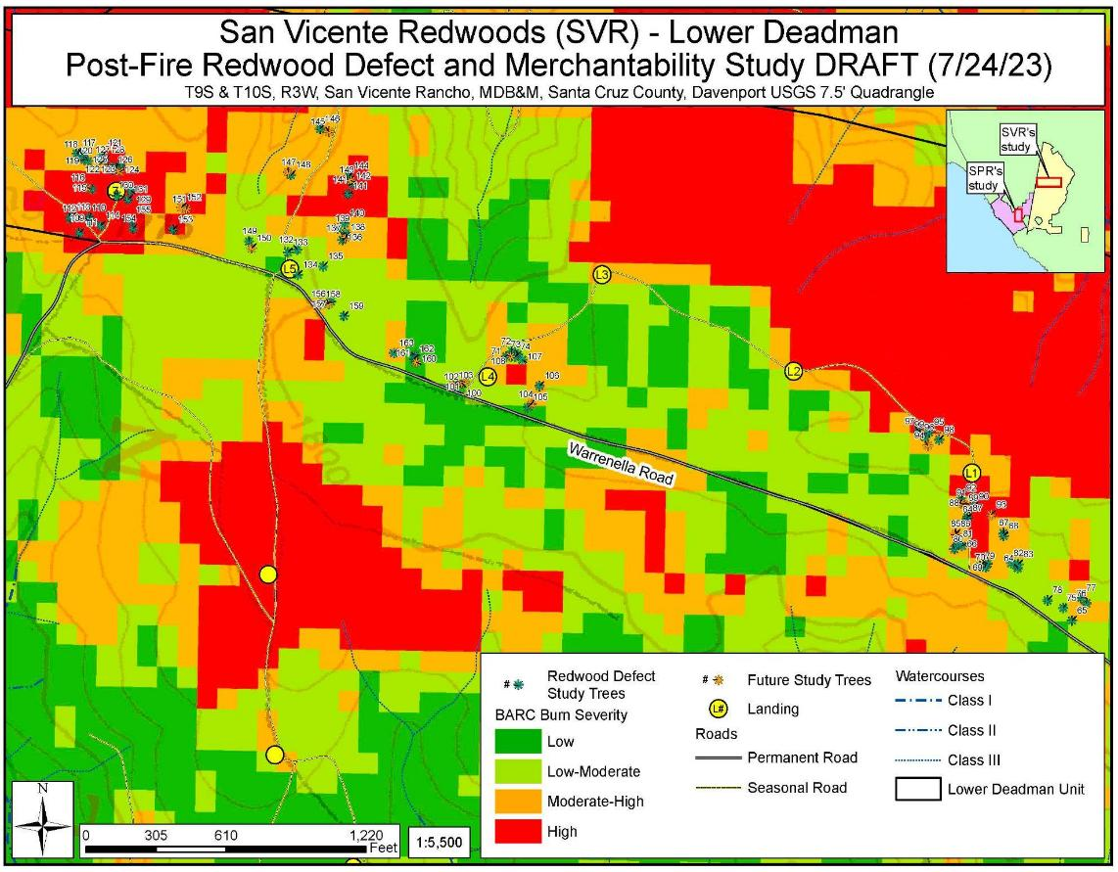
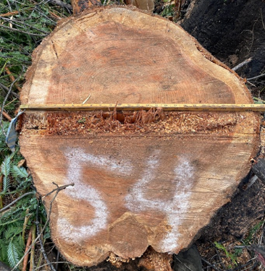
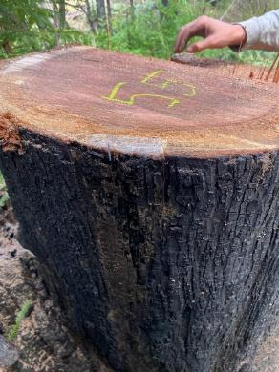
San Vicente Redwoods
228 harvested trees
  75 trees in 2023
  153 in 2025
  Plus 25 retained trees “future study trees”
Notes:
Test sites were permitted through the Lower Deadman Emergency Notice, Big Jim THP, and Phoenix THP
Trees chosen for the study spanned burn severities and diameter with a wide variey of fire affects and apparent wet rot.
Burned Area Reflectance Classification (BARC) Map from 2020 CZU Lightning Complex Fire. The study trees were a targeted sample of substantially fire-damaged redwoods, not random. And represented some of the highest defective trees or trees thought to have high defect

Slide 12
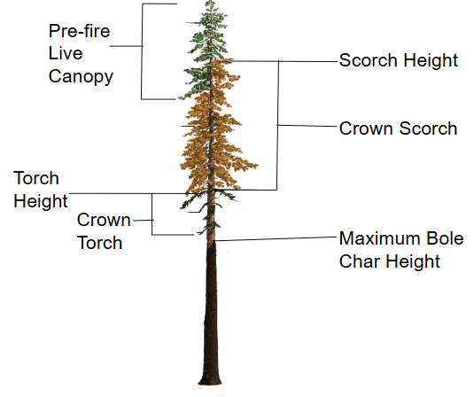

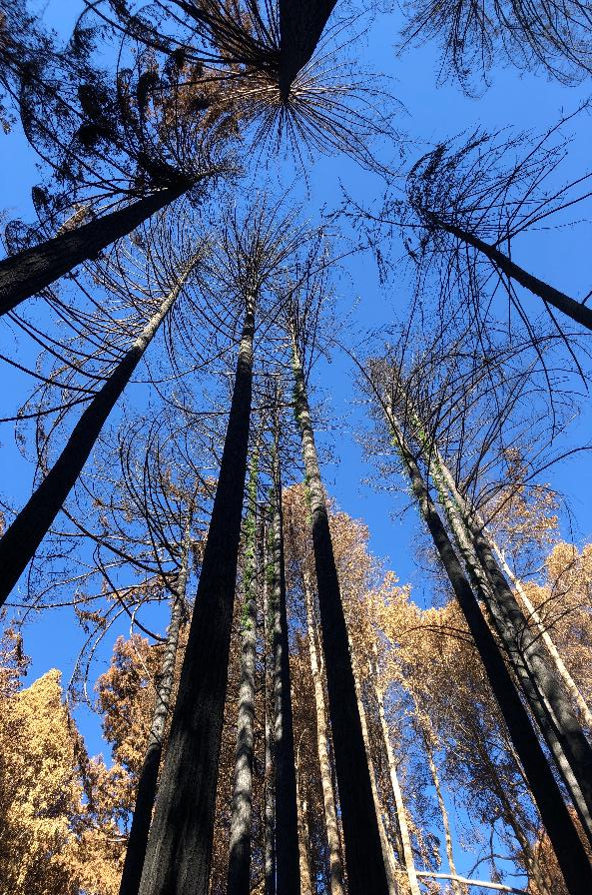
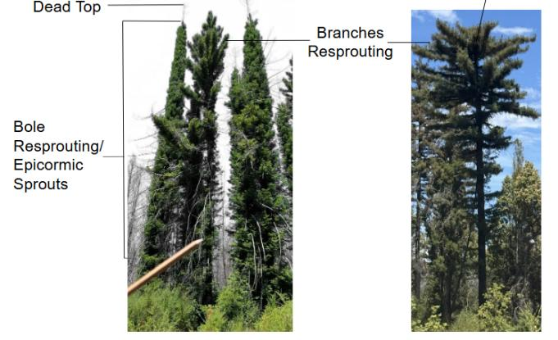
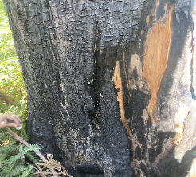
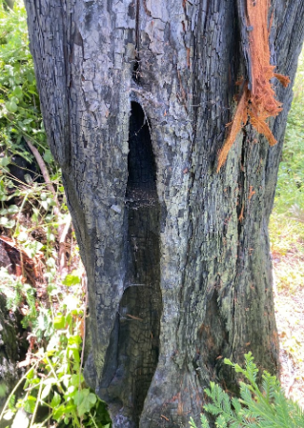
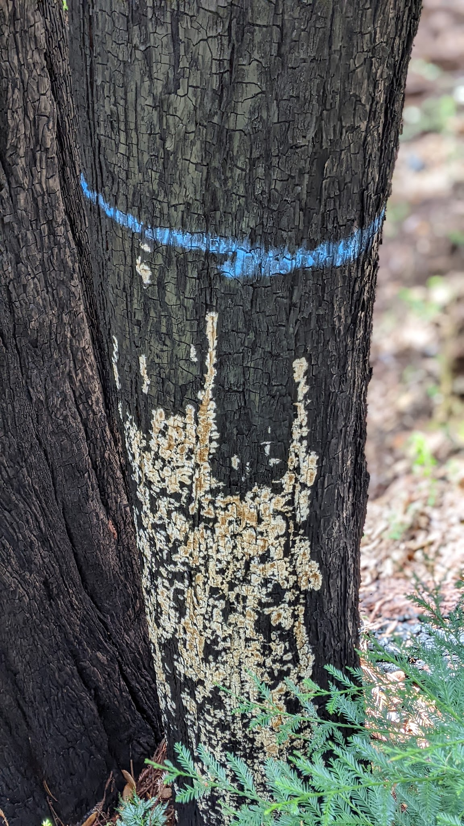
Tree characteristics
Fire injury
Fire response
Notes:
This study aims to identify resiliency thresholds in redwood trees by examining combinations of visual indicators of fire in trees. The goal was to correlate any of these attributes to varying degrees of decay, defect, and merchantability.
We measured scorch, torch, how high up those occurred, how high did the bole catch,
Whether there was any pre-existing live canopy that survived the fire, broken tops, dead tops, whether tree was sprouting from the base, branches, or both and to what degree?
the extent of wet rot We started off by measuring the height of fungus, thinking we could only see it from the base, but when we went to fall trees, we observed it at the tops of trees.
We also noted heights, diameter at breast height, and took lots of photos
As time progressed, we had to drop a few of these post-fire effects like scorch , max bole char height,
In year 5, we measured length of dead top, not something we could really see in years prior

Slide 13
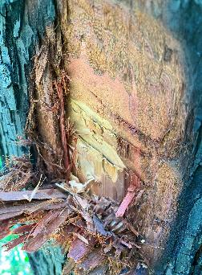
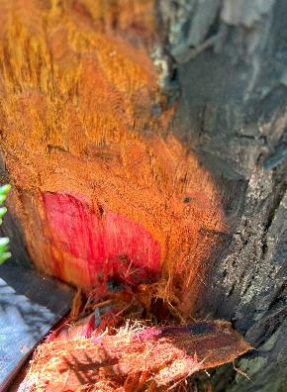
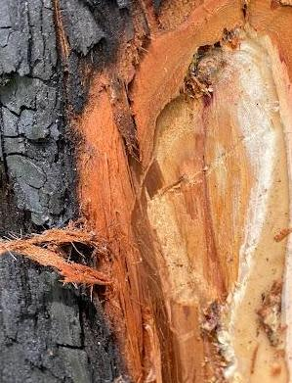
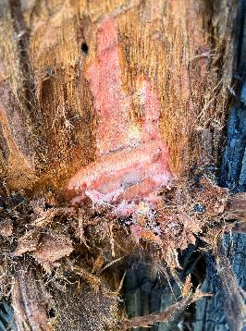
Cambium checks
North
Dead,
Fungus
East
Dead,
No fungus
West
Alive, Fungus
South
Alive,
No fungus
Notes:
The extent of dead cambium was evaluated by physically checking cambium condition per quadrant. Each tree was divided into four cardinal quadrants, where a hatchet was used to make a shallow cut at approximately 1m above ground (Figure 5). We identified the cambium as either live or dead based on color, moisture, texture, and adherence to the sapwood. In year 5, we also made visual estimates of cambium death before marking our hatchet cuts, to see how accurately we could identify dead cambium just by looking at the bole.
In addition, we noted whether we saw evidence of wet rot in each quadrant too.

Slide 14
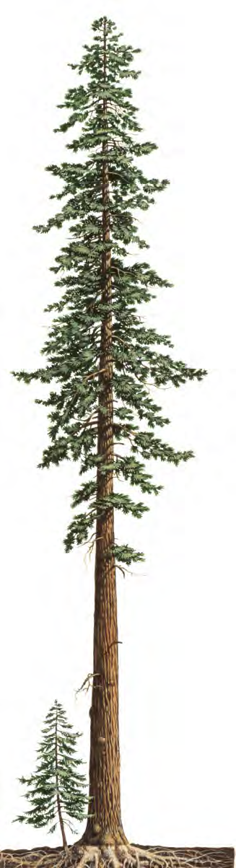
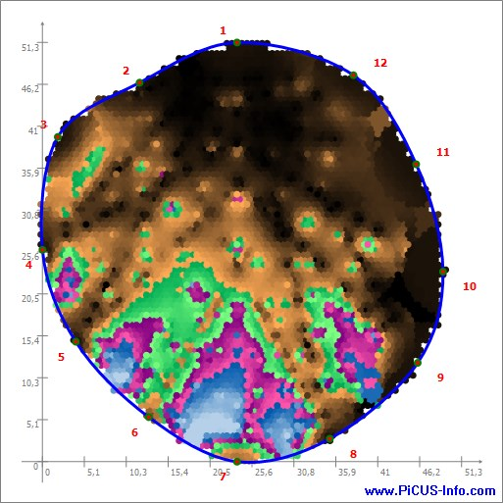
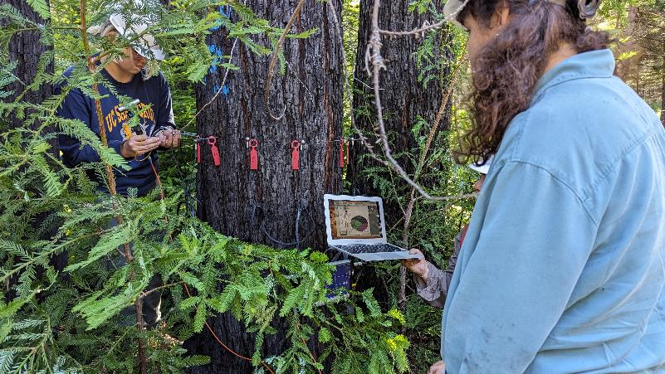
Sonic tomography
Noninvasive technology, PiCUS 3 Sonic Tomograph
Structural integrity at 1m from base
Measures velocity of sound
Sound travels faster in solid wood
= Decay
= Healthy
= Severe Decay
Notes:
In our 2023 Lower Deadman Unit, We also had the good fortune to work with Liz Rennie from Dr. Greg Gilbert’s lab at UCSC. She’s particularly interested in how plant disease plays a role in host species after fire and she used a sonic tomography machine set up at breast height at each tree to get a scan of the inside of each of our study trees before we cut them down.
Sonic tomography is a Noninvasive technology that allows us to look at the structural integrity of a cross section of a tree.
By installing nails just into the cabium around the circumference of the tree and sending pulses between them,
It produces a CT scan using acoustics to detect decay. Sound travels faster in solid wood, and slower in decayed wood.
Areas of good wood, where the fastest velocities can be found, are represented in (dark) browns. The greens, violets and blues represent damaged areas with more decay.

Slide 15
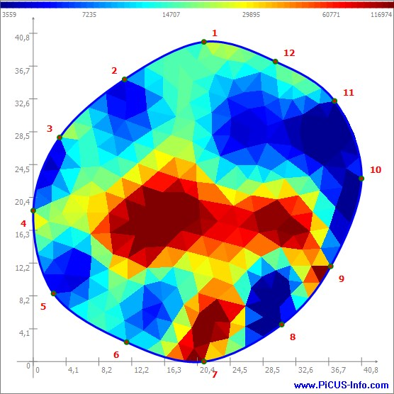
Electrical impedance
Noninvasive technology, PiCUS treetronic
Scan shows the water content of the same cross section
Develop electrical conductivity ‘map’
= Moist
= Dry
= Very Moist
= Very Dry
Notes:
Electrical impedance was also measured using the similar instruments to assess the electrical conductivity of the cross section to detect water content.
Blues indicate areas of low resistance (high water content), greens and yellows show increasing resistance, red indicates areas of high resistance (low water content)

Slide 16
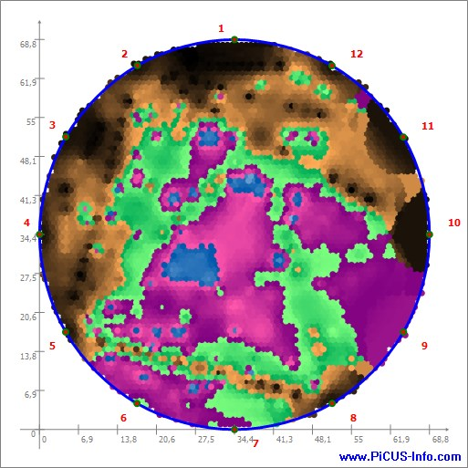
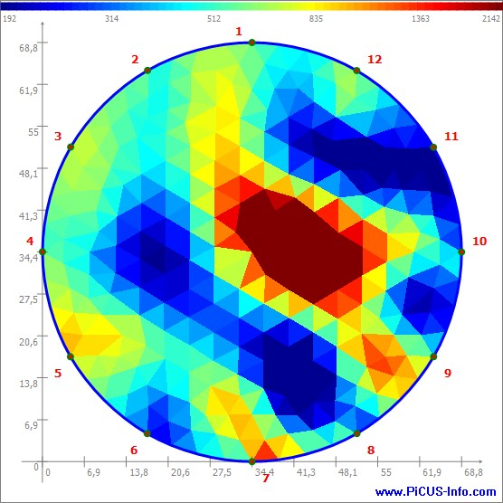
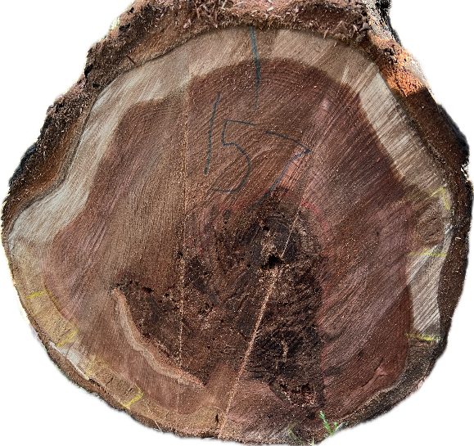
Sonic Tomography
Electrical Impedance
Cross-section
62% Decay
35% Severe Decay
= Sapwood Rot
= Heartwood Rot
Notes:
After cutting the trees, we were able to combine and compare all of the methods. We can see that the scans shows decay and dry and wet areas that the cross-section of the tree clearly shows.
On the cross-section there’s sapwood rot at the edges and heartwood rot in the center which is similar to the tomography scans. And since Coniophora is a wet rot we hypothesize that the areas with fungus will have more moisture content.
This log demonstrates one of the difficulties of the study, given the various rot pockets, it’s hard to isolate which are from pre-CZU , and which are caused by the recent fire.

Slide 17
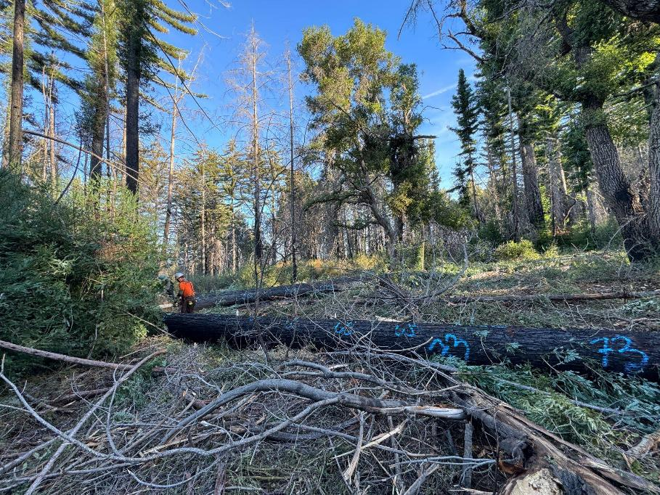
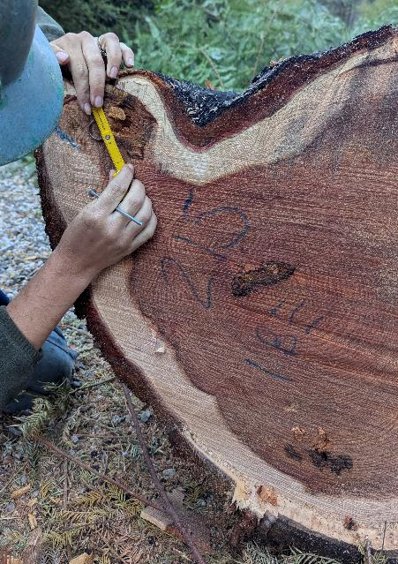
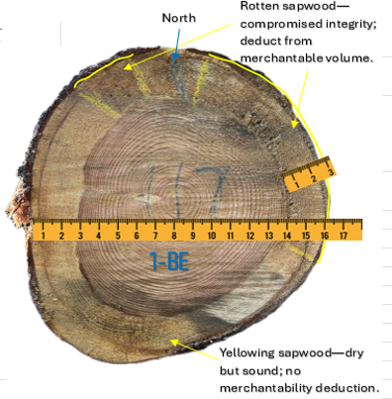
Logging
Notes:
We attempted to track study trees through the logging operations.
Ventana Forestry at Swanton Pacific Ranch and Santa Cruz Timber Company at San Vicente Redwoods. In both cases, the logs were delivered to Big Creek Lumber Co.
Before the logs were skidded, we attempted to locate and scale them – which proved difficult and we lost some. We also tried to track them to the mill to analyze the corresponding log scale and in a few cases were able to follow logs through the scaling process.
For each tree, we recorded how many merchantable logs it produced and the length of each log. We then looked at both ends of every log, measured diameter inside bark, and scaled the logs to calculate gross volume and the net volume and diameter remaining after defect deductions.”
Measured the depth of fire-related rot from the outer edge of the inner bark inward at both the big and small ends of each log and its range. We estimated the surface area of rot visible and whether there was any abnormal coloring in the sapwood.
Most of rot measurements were only observed in the sapwood, but we noted whenever it went into the heartwood.
With all of our measurements, we were only focused on defect that directly resulted from the CZU fire.

Slide 18
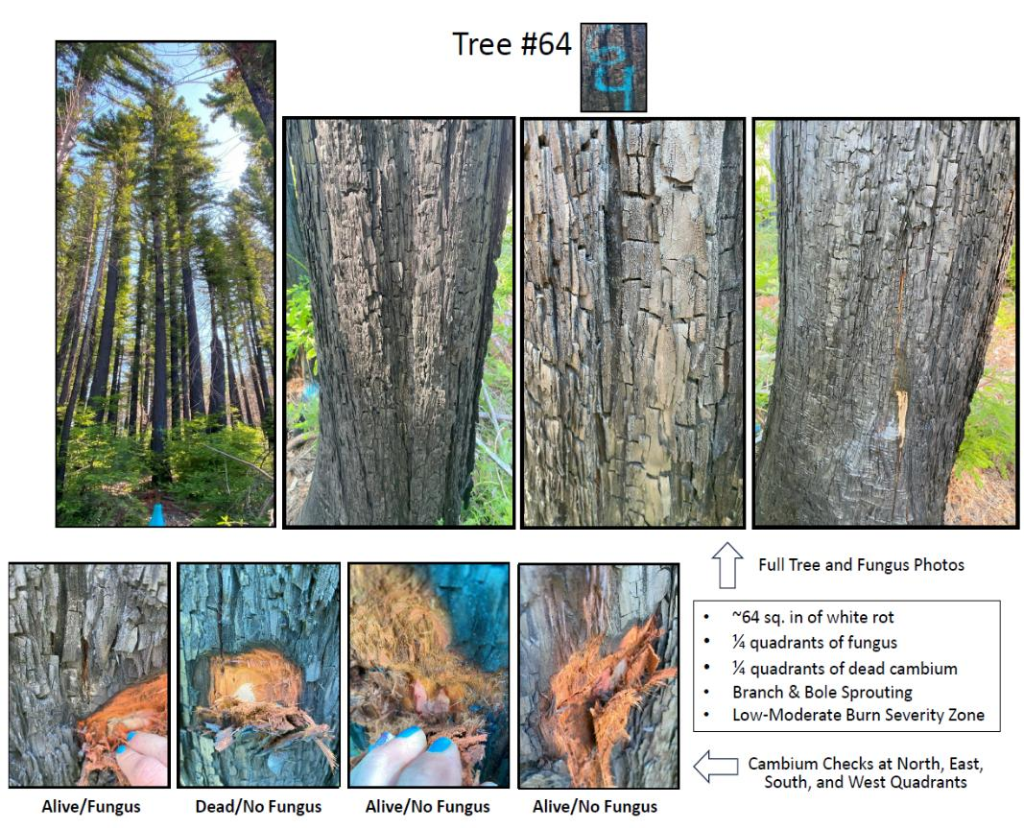
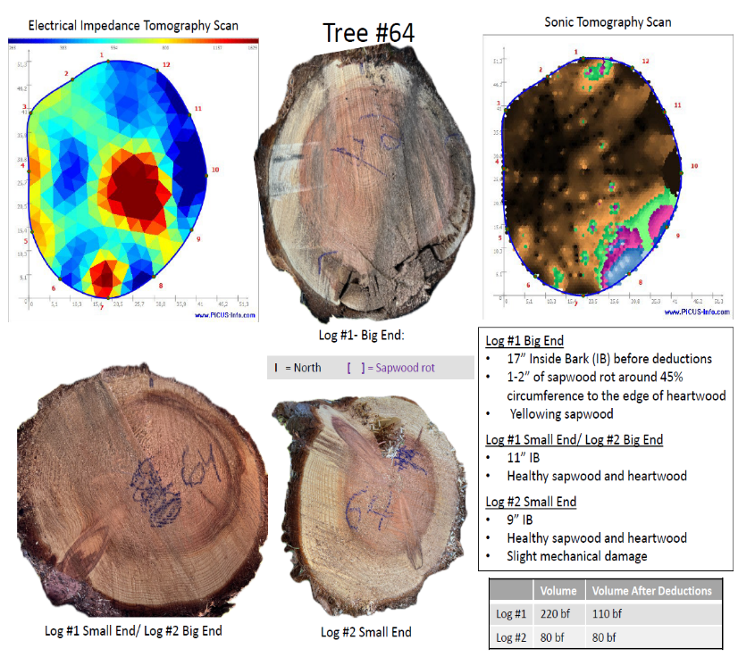
Notes:
Then we put it all together. Here is an example of a 20” study tree in a low-moderate burn severity zone that was sprouting from the branch and bole. Hatchet cuts revealed it had 1 quadrant of dead cambium and another quadrant that had wet rot. When we cut the tree, we saw 1-2” of sapwood rot around 45% of its circumference, resulting in a 2 inch diameter deduction that equated to a 50% volume deduction
The sonic tomography and electrical impedance showed wet and dry pockets, as well as rot. The scaling profile for log #64 shows that the first log has a 50% defect deduction and sound upper logs.

Slide 19
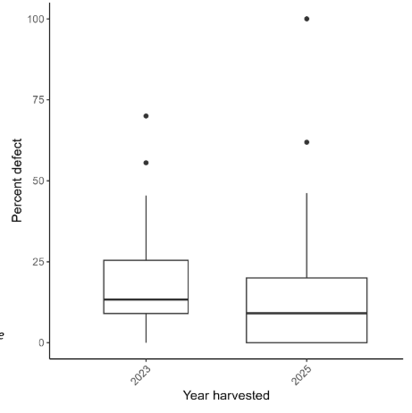
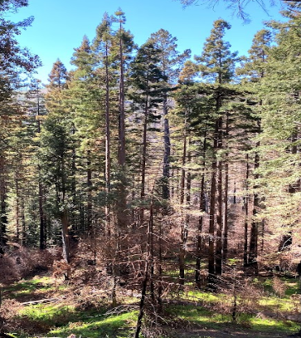
Linking tree-level observations & defect occurrence
Result #1:
Defect was common in fire-damaged redwoods
76% of harvested trees had at least some defect
Percent of volume with defect across all trees:
  Mean: 14%
  Median: 11%
  Range: 0-100%
Notes:
On a log scale, the first log generally had the highest defect, then the top log, The middle logs generally had little defect

Slide 20
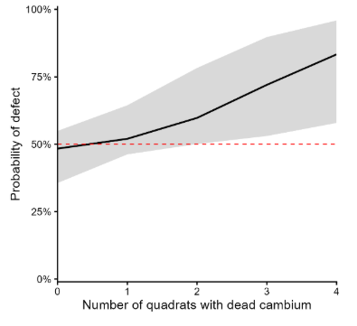
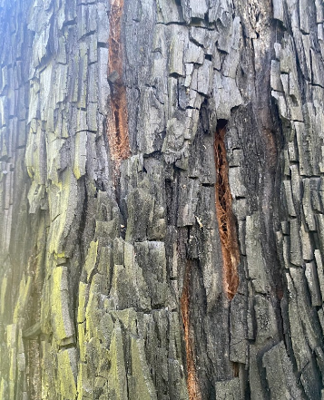
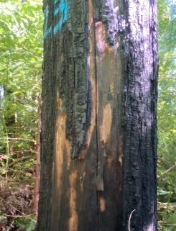
Linking tree-level observations & defect occurrence
Result #2
More dead cambium = greater likelihood of defect
0 dead quadrants → ~50% probability of defect
3+ dead quadrants → >70% probability
Notes:
Of everything measured, the extent of dead cambium was probably the most useful early field indicator.

Slide 21
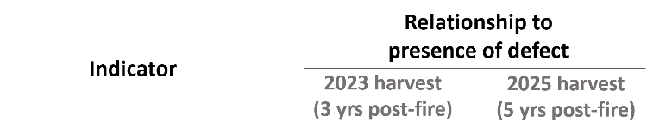
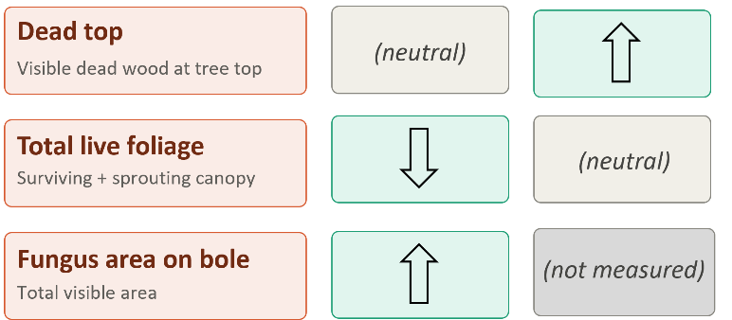
Linking tree-level observations & defect occurrence
Result #3
Different metrics with different time since fire
3 years post-fire
Live foliage was more informative
Visible fungal area could still be measured
5 years post-fire
Dead tops became a strong predictor
Initial fire evidence had begun fading
Fungal visibility had faded
Notes:
The best field indicators are not necessarily static through time.”
Total live foliage, which includes the amount of surviving canopy and new sprouting available to support recovery, was also an important predictor, particularly for trees harvested in 2023. This metric likely reflects overall post-fire tree vigor. Reduced live foliage is likely due to the mortality of buds that sprout post-fire, and we suspect that cambium death is more likely where bud kill occurred.

Slide 22


Linking tree-level observations & defect occurrence
Result #4
When defect occurred, smaller trees lost a
greater proportion of merchantable volume
Notes:
Among trees that had defect, the best model for how much defect they had included DBH alone; smaller trees were associated with a greater percentage of defect.
Smaller redwoods have less total stem volume and generally thinner bark, so the same degree of injury/decay can represent a larger proportion of the merchantable stem.
In the 2023 trees, greater visible fungal area also corresponded with more defect, particularly at very high fungal coverage, but that indicator became less useful over time because visible fungus faded.

Slide 23

Linking tree-level observations & defect occurrence
Result #5
We can flag high-risk trees better than we can
rule out defect
83% of trees predicted to have defect actually had defect
59% of trees predicted not to have defect actually lacked defect.
No reliable “defect-free” threshold emerged.
Notes:
We did not find the clean threshold we originally hoped for, something where we could look at a tree and confidently say, ‘this one is fine.’ What we did get better at was recognizing trees that are particularly likely to contain defect.

Slide 24


Takeaways
Defect was common, but highly variable
We needed to collect data from more trees with a greater variation in fire damage
We can identify trees at high risk of defect better than we can identify trees that are definitely sound.
Notes:
Takeaways: The sample was targeted, not random. Because we selected study trees from trees marked for salvage, defect was common in our study trees. We needed to collect data from more trees with a greater variation in fire damage to complete the picture.
Our study doesn't propose a new regulatory threshold, but it does provide additional information to support the professional judgment foresters use when evaluating fire-damaged redwoods and making post-fire management decisions to preserve their option to manage high-quality timber products in the future, and to potentially meet other ecological or carbon objectives

Slide 25



What does this mean for the forester?
Immediately/early post-fire
document crown condition and visible fire effects before they fade
physically check cambium; don't rely solely on outward appearance
As time goes on…
watch for dead tops, failed crown recovery, and reduced live foliage
Identify trees with potential deep fire-related injuries to guide salvage decisions and reduce future cull volume.
Notes:
What does this mean for the forester? Visual indicators change over time as the trees recover. Immediately post-fire you can look at things like crown scorch and torch, and make physical cambium checks with a hatchet. As time goes on, you can watch for dead tops, reduced live foliage, and cracks developing between bark plates.
We developed the three-strikes rule. If the tree has 1) Dead top, 2) Bole sprouting not branches, and 3) Cambium damage on 2+ quadrants, there is significant decay.
The presence of a dead tree top often correlates with yellowing and checking of the sapwood, which is anticipated to progress to rot of the sapwood and the heartwood over time. Foresters targeting immediate post-fire salvage harvesting may miss trees with significant underlying injury because indicators such as dead tops and crown recession may not develop until several years after the fire. Our study doesn’t give us a perfect threshold, but it gives RPFs better information to make that initial post-fire decision.

Slide 26


Notes:
We developed a companion field guide that’s included in Appendix C of our Report, to translate both our study observations and anecdotal observations into practical field guidance. The guide provides visual references for evaluating post-fire stand conditions in a coast redwood forest.

Slide 27



Other Objectives
Habitat
Canopy retention
Carbon
Notes:
We hoped this research would shed light on the impact of fires on the creation of rot pockets that could potentially lead to basal hollows. While we did get a start on that, more work is needed.
Foresters are tasked with balancing timber production with other forest values. More ways to interpret the signs of defect gives the forester more information to base their decisions on.
The results can help identify which trees have the highest likelihood of defect, rather than treating every surviving burned redwood the same.

Slide 28



Data collection for the future
Notes:
Due to the long-term nature of post-fire rot response in redwood, it would be great if work could continue on this project. We have not used the entire budget and we collected the full suite of study data on 25 trees that are still standing that can be monitored in the future with tomography and analyzed to shed light on how defect progresses within an individual tree through time.
The tomography data we collected with UCSC for this study has yet to be analyzed quantitatively. We could assess both the electrical impedance and the sonic tomography scans quantitatively to compare to the tree cross-sections and hone the relationship between the scans and wood quality.
We have hopes of continuing to collaborate and potentially using tomography to assess trees before and after prescribed burns, to track how much defect is introduced to Working Forests where we intend to burn.
We recently toured JDSF and were inspired talking to JDSF staff and UCCE Mike Jones and Tori Norville about the possibilities.
It would be interesting to establish more monitoring early on following a fire in redwoods. This could provide valuable insight into immediate indicators and long-term recovery. Repeated measurements would help determine when key post-fire indicators, such as visible cambium damage, dead tops, sprouting failure, fungal presence, and crown condition, first become apparent and begin to fade.

Slide 29

Acknowledgments
Board Of Forestry – Effectiveness Monitoring Committee
Landowners
Peninsula Open Space Trust
Sempervirens Fund
California Polytechnic
State University-San Luis Obispo
Save the Redwoods League
(Conservation Easement Holder)
UC Santa Cruz
Dr. Gregory Gilbert
Liz Rennie
Madison Evanow
Kirra McColl
Klaire Richardson
Contractors
Santa Cruz Timber Co.
Ventana Forestry
Dan Guffie
Brett Lambert
Roger Prefontaine
Louie Fusari (Big Creek Lumber)
Bob Reynolds (Big Creek Lumber)
Johnny Cree (NW Scaling Bureau)
Hamey Woods
Nadia Hamey
Clare Lacy
Kristy Swor
Other
Big Creek Lumber
Kristen Shive (UC Berkeley)
Spike Campbell (UC Berkeley)
Alexis “Lex” Bernal (UC Berkeley)
Shrabya Timsina (UC Berkeley)
Chuck Sweeney (Swanton Pacific
Ranch)
COR Large Grant Program
Notes:
There are so many people to thank! Thanks to you, the Effectiveness Monitoring Committee for funding this effort.
Thanks to Kristy Swor and Clare Lacy, Hamey Woods Foresters for field data collection and analysis
Thanks to Kristen Shive at UC Berkeley for data analysis and reporting, and Lex Bernal, and Spike Campbell at UC Berkeley for preliminary analysis
Thanks to Liz Rennie and her team at UCSC for their help doing tomography on our study trees, including the trees we continue to track.
Thanks to the Conservation Partners at San Vicente Redwoods
And Cal Poly Partners at Swanton Pacific Ranch for letting us conduct the study on their land
And thanks to our contractors: Santa Cruz Timber Co. and Ventana Forestry and Big Creek Lumber Company, and log scalers from the Northwest Scaling Bureau who helped us carry out the study!

