Slide 1

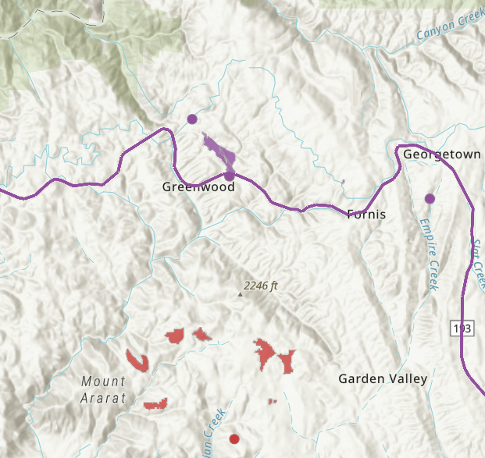
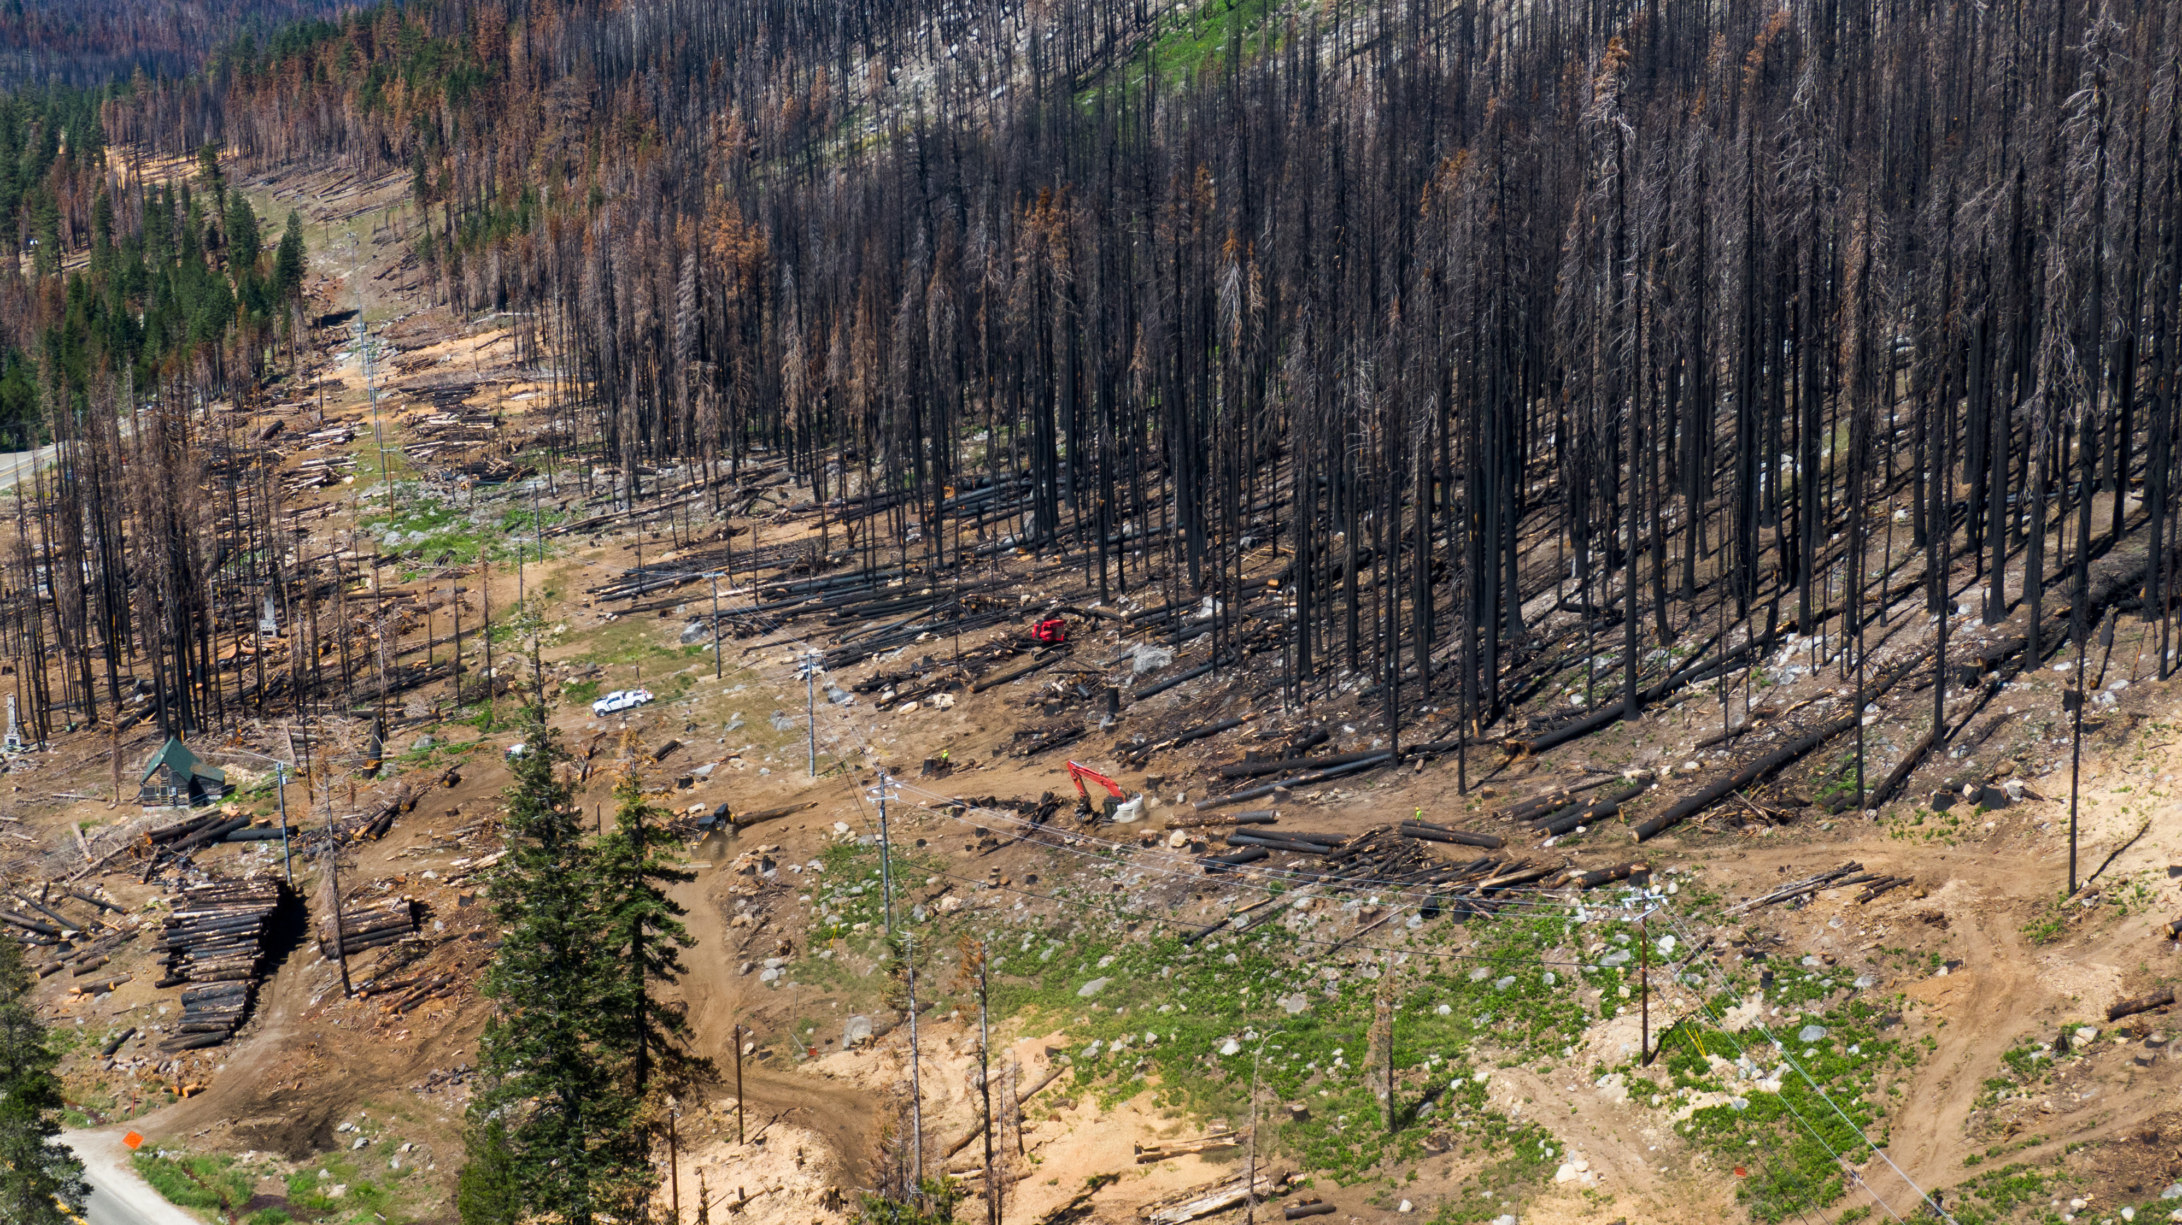
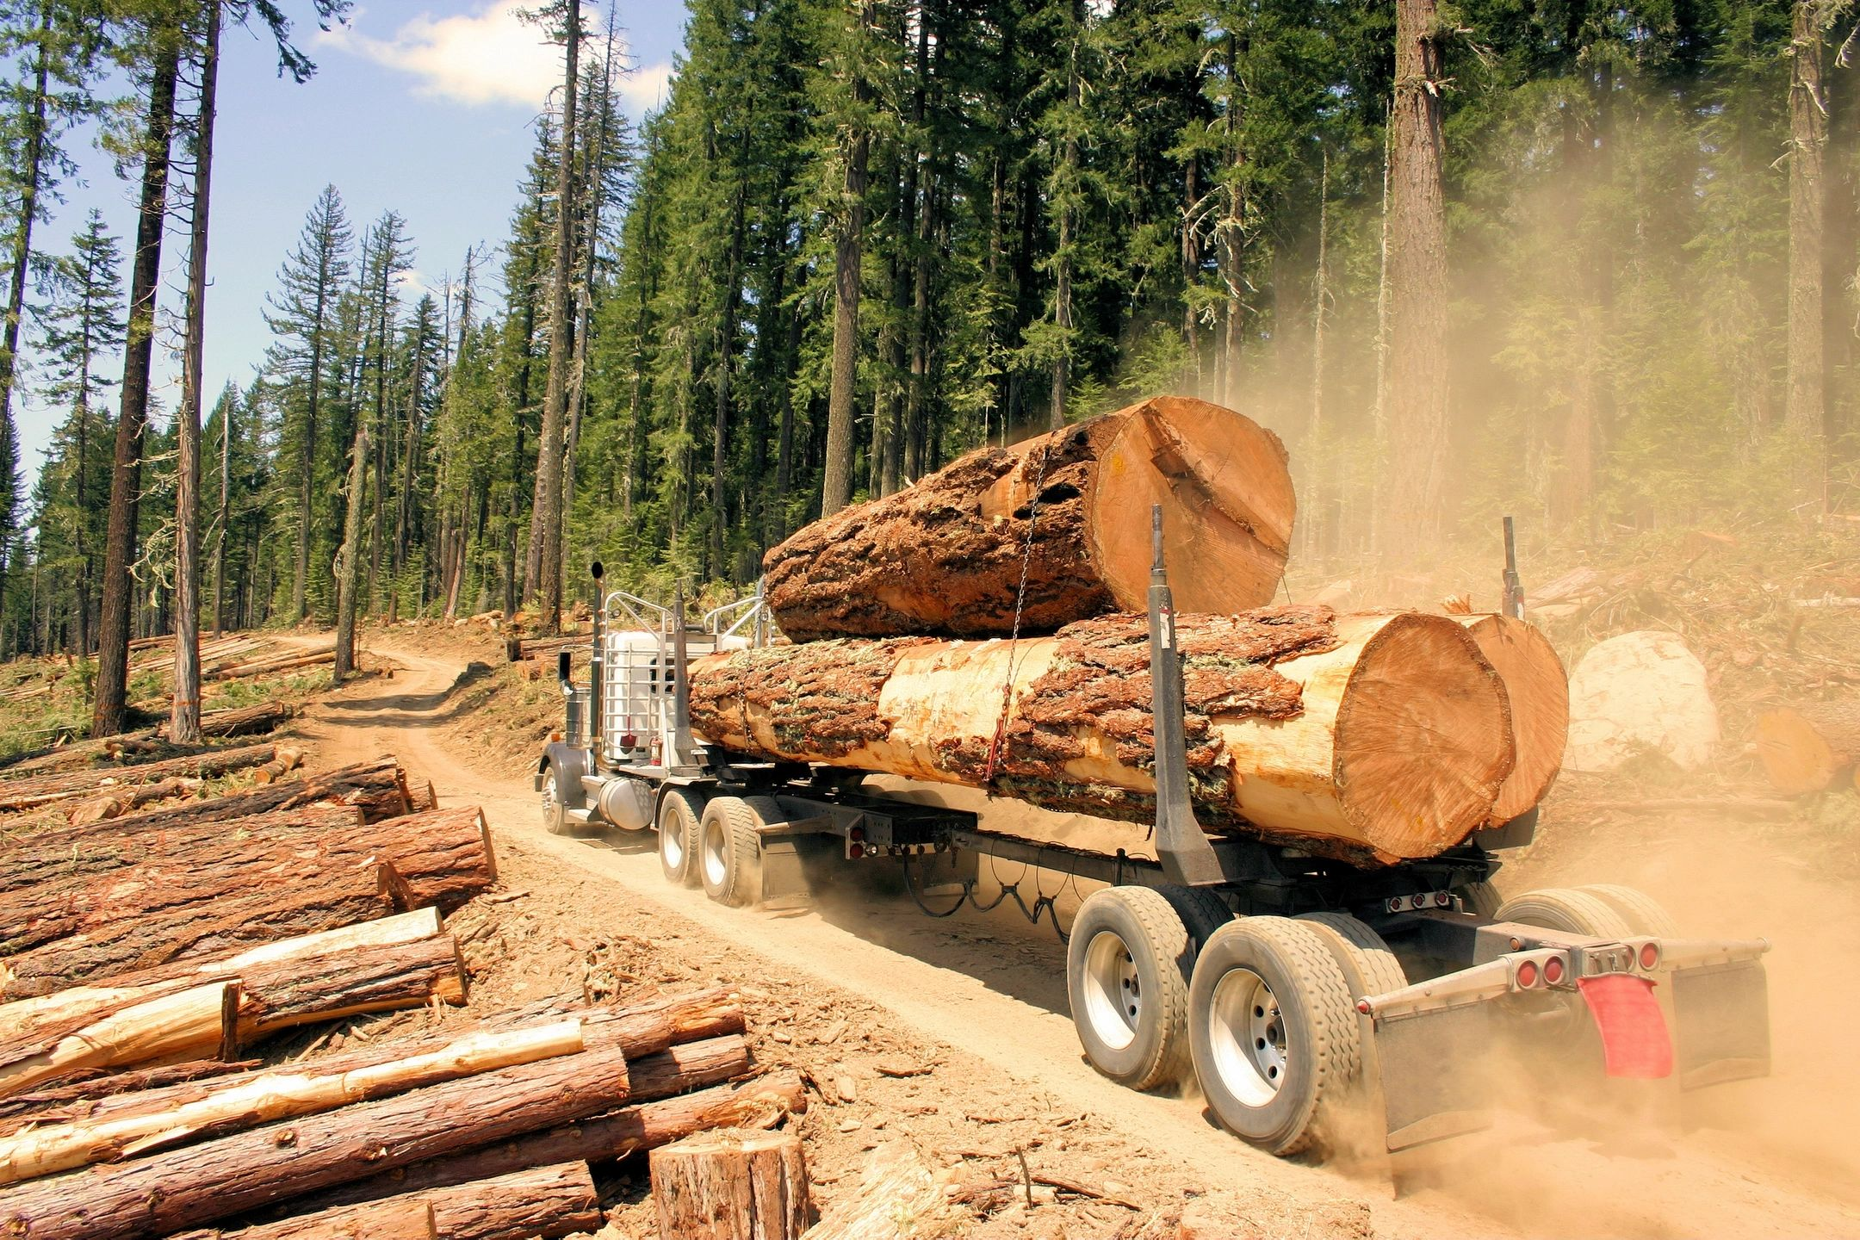

Board of Forestry | Forest Practice Committee
Geospatial Data Submissions
August 19, 2025
Loretta Moreno, Environmental Program Manager
Timber Regulation and Forest Restoration Program
Notes:
Need for modernization in our collection of data in the forest management space. We’ve come a long way and we need to do more.
We know timberlands heavily contribute to the landscape, and thoughtfully manage lands. To draw needed insights into this work being done, we need management data reported aligned with permits.

Slide 2
Mandates to Assess Working Lands

Slide 3
Why account for land management activities?
AB 1492
Directs the Timber Regulation and Forest Restoration Program to develop statewide ecological performance measures (EPM) as an accountability measure for the multiple State programs that regulate timber and forest lands statewide, regardless of ownership
  The EPM approach includes traditional timber harvest activities as well as efforts to invest in forest health and wildfire resilience.
  Data on where management has occurred is required to perform the required assessments.

Slide 4
Why account for land management activities?
SB 901
Requires CARB to quantify how forest management influences carbon on the landscape.
  Data on where management has occurred is required to perform the required assessments.

Slide 5
Why account for land management activities?
AB 203
On or before December 31, 2022, CAL FIRE shall develop a standardized protocol for monitoring implementation and evaluating the positive and negative ecological and fire behavior impacts from vegetation management projects undertaken by the state...
  The reporting and monitoring requirements …shall be expanded to other state agencies that undertake or fund hazardous fuel reduction and vegetation management projects by December 31, 2024, including, but not limited to, projects funded or conducted by state conservancies, the Department of Fish and Wildlife, or the Department of Parks and Recreation.
  Data on where management has occurred is required to perform the required assessments.

Slide 6
Why account for land management activities?
SB 456
Directs the Wildfire and Forest Resilience Task Force to report progress made in achieving the goals and key actions identified in the state’s “Wildfire and Forest Resilience Action Plan,” on state expenditures made to implement these key actions, and on additional resources and policy changes needed to achieve these goals and key actions.
  The Action Plan includes a target to treat 1 million acres by 2025 to address risk of catastrophic wildfire, and therefore requires tracking of total acres treated, type of treatment, and acres that received maintenance treatment.
  Data on where management has occurred is required to perform needed assessments.

Slide 7
Why account for land management activities?
AB 1757 /Nature-Based Solutions Climate Targets
Starting in 2025, and every two years thereafter, the Natural Resources Agency is required to publish data on progress made in achieving the targets, including on state expenditures.
CARB is required to develop standard methods to track outcomes of these NBS.
  Data on where management has occurred is required to perform the required assessments.

Slide 8
Key Questions and Applications
How many footprint and activity acres were accomplished annually?
1
Where did those actions occur?
2
Are we reaching our targets and objectives in terms of what effect these actions are having on ecosystems and communities?
3
How do efforts in implementing specific land management activities vary across the state spatially and temporally?
4
How much of the work being done is being managed by State, federal local govt., CA Native American Tribes, non-profits, and private landowners?
5
How much of the work towards implementing the State Targets and 30x30 are being funded by the State?
6
Which land management practices across ownerships are succeeding in meeting their stewardship goals and where can improvements be made?
7
Notes:
- Working Lands: How have things changed, why have things, changed, what are the repercussions of these changes, what can we do to improve?
The breadth of the mandates requires the State to report on and assess a range of land management activities occurring across California covering diverse geographies, ownerships, land cover types, and funding sources, as resources allow. This largely involves tracking diverse forms of vegetation management across the State to understand.
Management effectiveness
Aboveground biomass dynamics
Disturbance pattern
Land cover dynamics
Fire severity assessment
Tree mortality assessment
Etc.

Slide 9
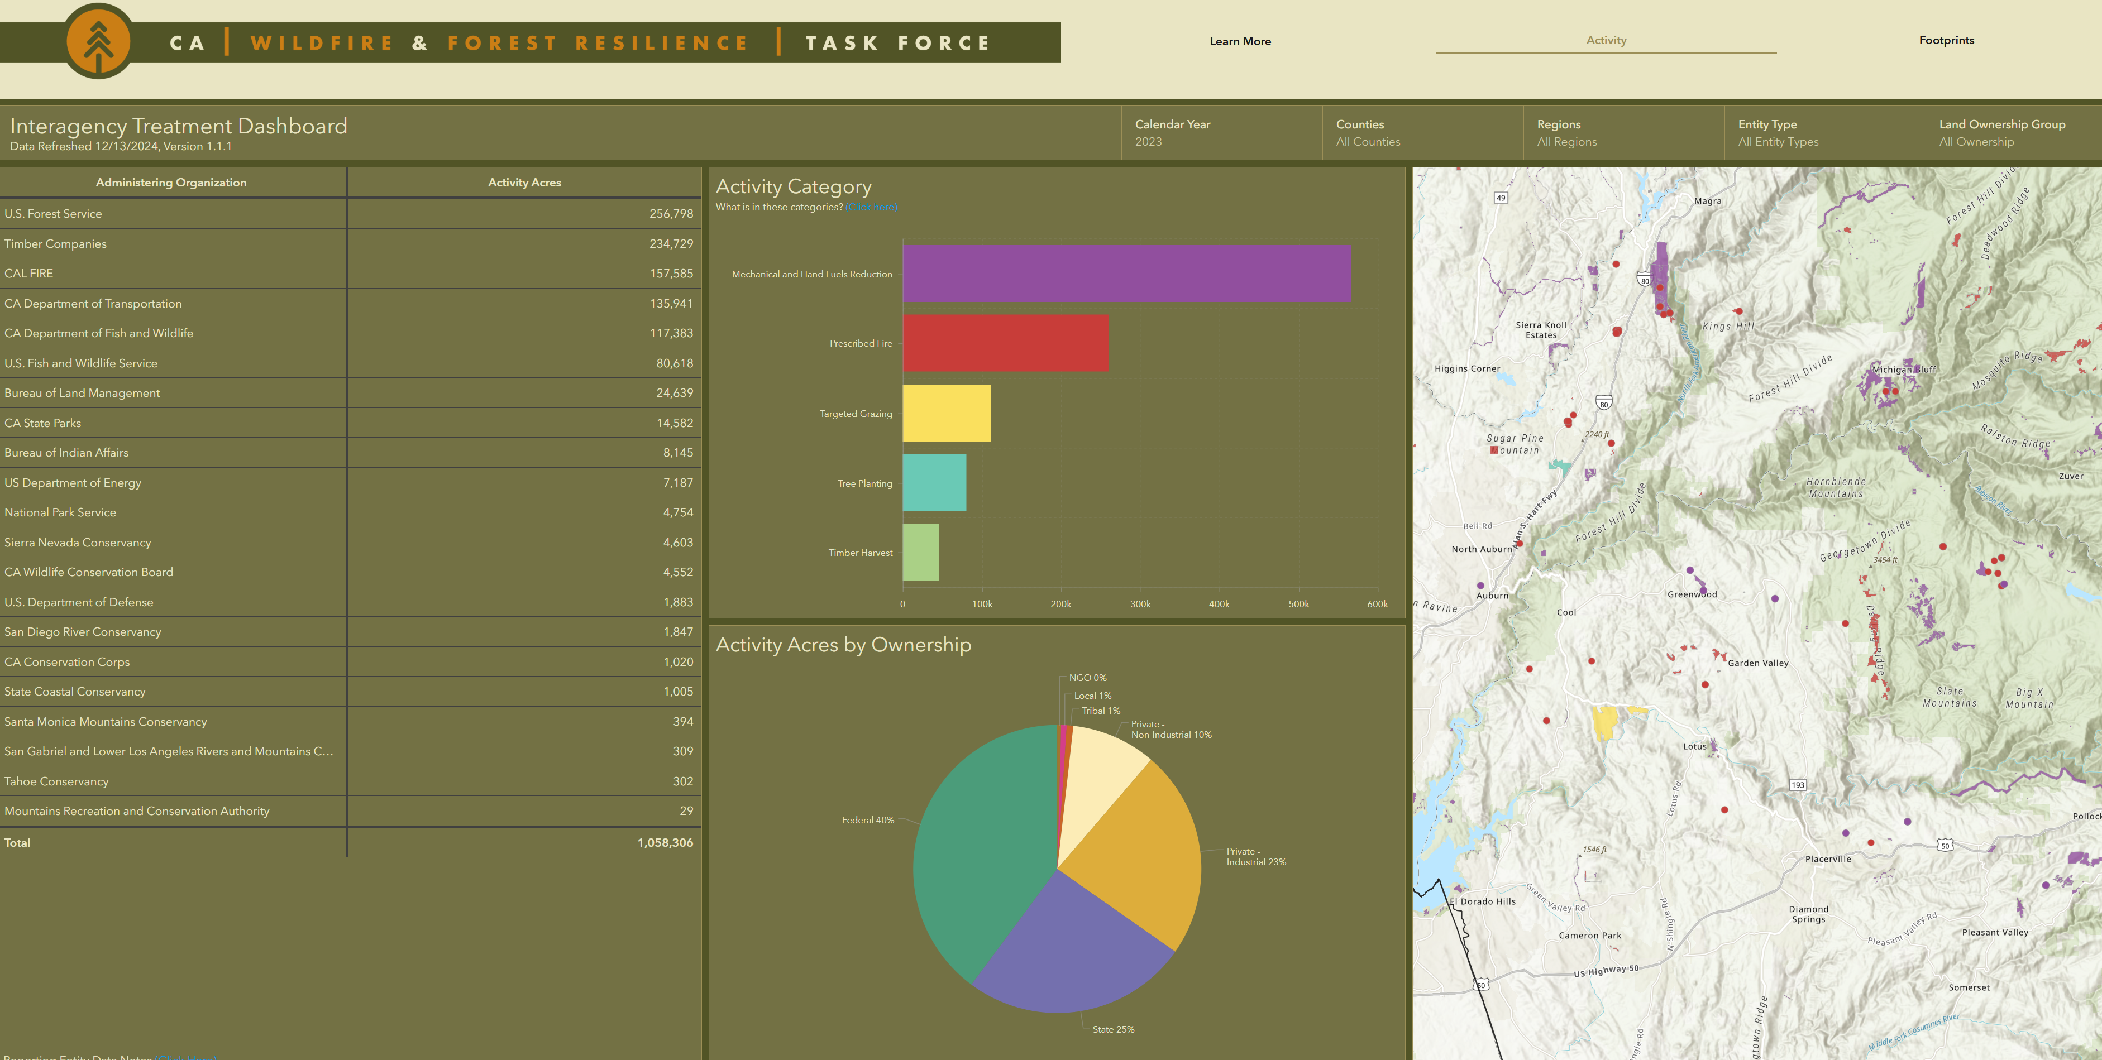
Notes:
Currently Reported Data is Incomplete and tabular or manually digitized.
Task Force Tracking System – reported industrial data is in the ocean.
Forest Practice GIS Teams is spending ~70% of about 7-8 staff people’s time manual digitizing at present.

Slide 10
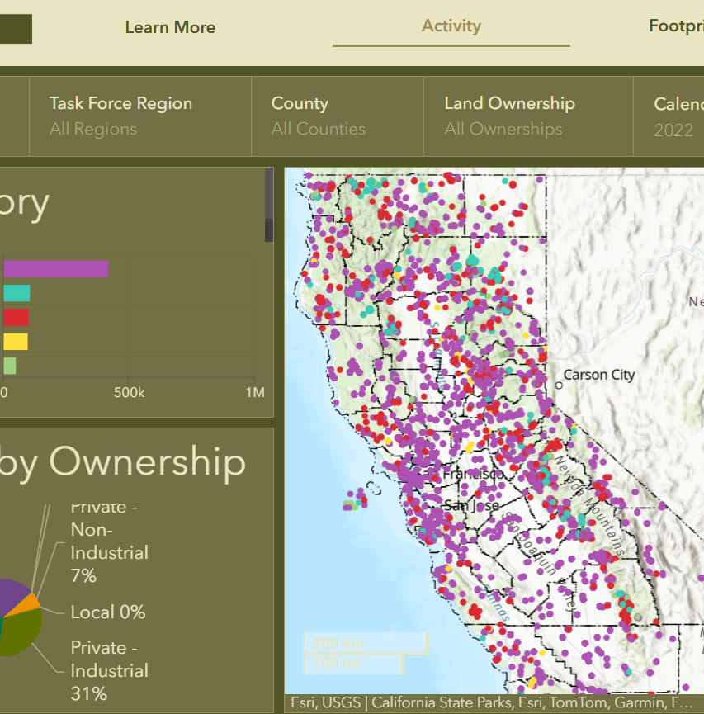
Notes:
Currently Reported Data is Incomplete and tabular or manually digitized.
Task Force Tracking System – reported industrial data is in the ocean.
Forest Practice GIS Teams is spending ~70% of about 7-8 staff people’s time manual digitizing at present.

Slide 11
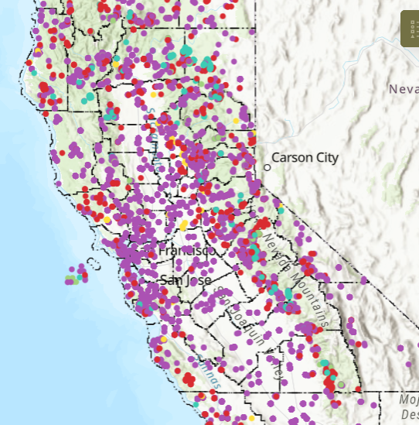
Notes:
Need to modernize our data collection approach and ensure timberlands management is accurately accounted for and contextualized

Slide 12
Essential data needs include:
• Geospatial information as to where the activity occurred
• When the activity occurred [initiated and completed]
• What activity occurred
• Whether the activity was funded by the State or other entity and budget, where known
Data Acquisition Scope
Notes:
What is needed.

