Slide 1
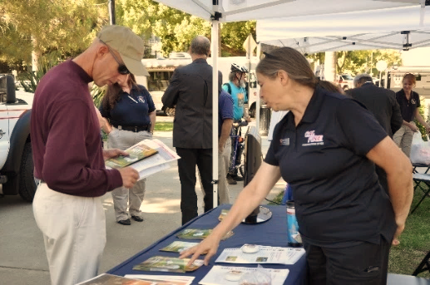
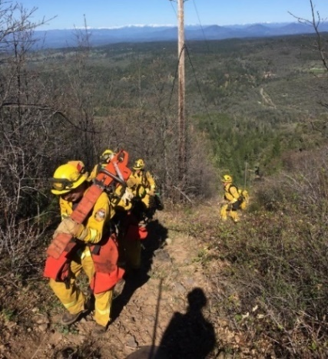
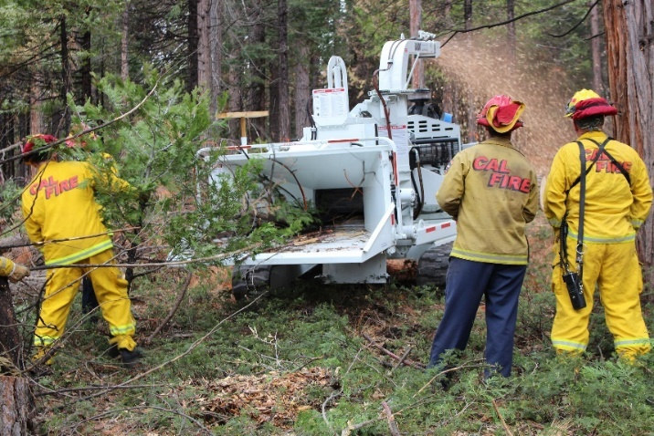
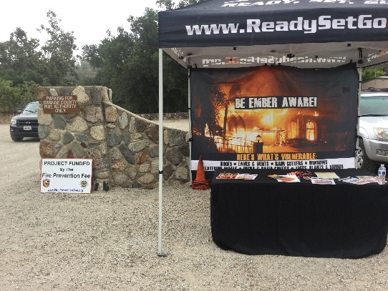
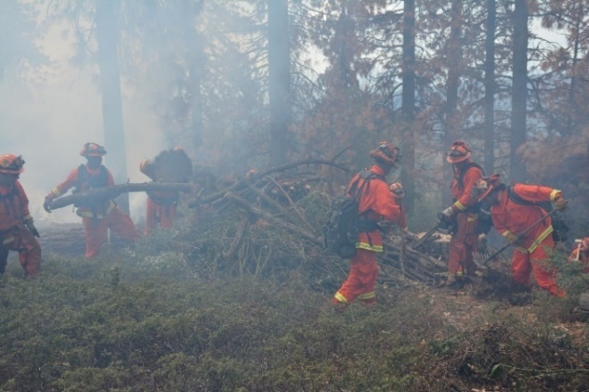
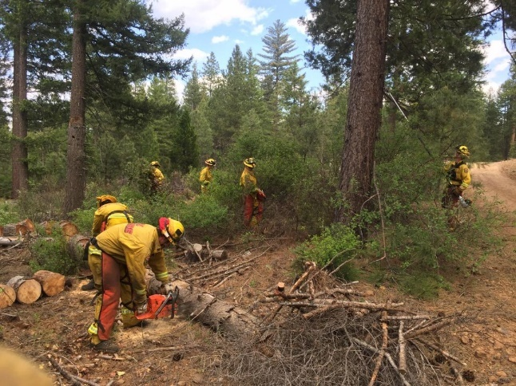
CCI Wildfire Prevention Grants Workshop FY 2023-2024

Slide 2
Wildfire Prevention Grants Program
Reduction of Greenhouse Gas Emissions
Fewer wildfires
Reduction in total acres burned
Structures not damaged or destroyed by wildfire
Benefits low-Income and disadvantaged communities
Protection of people, structures, and communities
Procedural Guide Page 2

Slide 3
Grant Projects
Activity Types:
Hazardous Fuels Reduction
Wildfire Prevention Planning
Wildfire Prevention Education
Procedural Guide Pages 2-3

Slide 4
Prescribed Grazing
Eligible activity under Hazardous Fuels Reduction
Projects with a grazing component must be seasonal and temporary
Infrastructure must be temporary
Consistent with increasing the protection of people, structures, and communities
Procedural Guide Page 3

Slide 5
Eligible Applicants
State and Federal Agencies
Native American Tribes
Joint Powers Authority (JPA)
Local government and special districts
Non-profit organizations with a 501^{(c)3} designation
Procedural Guide Page 4

Slide 6
Highlights for FY 2023-2024
Grants Portal Application Process
Project tracking numbers auto-assigned
Recommended funding amount is $3 million or less
Purchase of equipment not to exceed $750,000 cumulative
Procedural Guide Pages 3, 5, 16

Slide 7
Application Process
Grants Portal
Solicitation link and Grants Portal user guides posted on WP Grants Website
Grant application
Open date: November 1, 2023
Close date: January 10, 2024, 3:00 PM PST
Procedural Guide Pages 8, 9, 16

Slide 8
Application Package Best Practices
Procedural Guide
Relationship with local CAL FIRE Unit Foresters
Submit all required documents in Grants Portal
View the complete list in the Procedural Guide
Remember to complete the Budget Worksheet
Remember to submit the application
Verify signature forms are signed
Procedural Guide Pages 9, 15, 16, 38

Slide 9
Application Package Best Practices Continued
Naming your project
Use file naming convention for all uploaded files
Unique Project Tracking Number plus document name
23-WP-UUU-XXXXXXXX-STD 204.pdf
Project Tracking Number auto-generated in Grants Portal
Zip multiple files of same type
Data should match across all forms
Procedural Guide Pages 16, 30

Slide 10
Application Package Best Practices Wrap-Up
Report accurate treatment acreage
Funding total should match across all forms
Complete and submit early!
Procedural Guide Pages 7, 14, 30

Slide 11
Scope of Work
Project description
Include the number of acres to be treated for fuels reduction projects
Section I: Primary Activity Type
Section II: Degree of Risk
Section III: Community Support
Procedural Guide Pages 7, 12, 13, 14

Slide 12
Letters of Support & Commitment
Letters of Support
Letter writer supports the project
Uploaded in Grants Portal
Letters of Commitment
Letter writer a partnering agency or collaborator
Identify involvement and specific contributions
Required for projects with matching funds or services
Procedural Guide Page 14

Slide 13
Scope of Work Continued…
Section IV: Project Implementation
Section V: Administration
Section VI: SOW Budget
Narrative of costs
List budget breakdown by category
Section VII: California Climate Investments
Procedural Guide Pages 14-15

Slide 14
Budget
Use correct budget categories
Supplies or Other <$5,000
Equipment >$5,000
Include CEQA/NEPA costs, if applicable
Acres must match application and SOW acres
Mileage rates cannot exceed IRS allowable rates
Round up to the penny.
Complete the budget narrative at the bottom
Procedural Guide Pages 7, 20, 21, 24, 25

Slide 15
Goals
Acres of Fuels Reduction
Acres of Prescribed Fire
Educational Events
Community Plans
Procedural Guide Page 7

Slide 16
California Environmental Quality Act (CEQA)
Projects requiring CEQA review must provide documented compliance within 12 months from the grant execution.
Groundwork cannot begin until CEQA requirements have been completed.
Include CEQA costs into application package and budget.
Coordinate with your local Unit Forester for further CEQA details.
Procedural Guide Pages 4, 6, 7, 9, 19, 26-28

Slide 17
Post Award
Advances
Specific eligibility and requirements in Procedural Guide
Reporting
Financial
Progress and Final
Treatment acres and data
Project photos; pre and post work
Procedural Guide Pages 7, 8, 9, 23

Slide 18
New for FY 2023-2024 Project Mapping Program
Eliminated Project Influence Zone (PIZ) polygon requirement
Fuels reduction projects required to submit a Geopoint and Treatment polygon(s)
Planning and education projects will submit Geopoint only
Procedural Guide Pages 16, 17, 32, 36, 37, 38

Slide 19
Project Mapping Program
All projects must submit a Geopoint
Geopoint should be the center of your project
Fuels Reduction projects require a Geopoint and Treatment polygon(s)
Drawing a polygon for the entire state of California is not acceptable
Request access: Project Mapping Program
Procedural Guide Pages 16, 17, 32, 36, 37, 38

Slide 20
Review and Award Process
Unsuccessful Applicants Notified
Final date to submit grant applications and Project Mapping Program
Review of Applications
Successful Applicants Notified to Receive Grant
Grantees May Start Working on Project
Grant Agreements Executed
Grant Agreements Issued
Procedural Guide Pages 15-18

Slide 21
Office Hours
Virtual “Office Hours” for additional help
Dates and topics posted on our website
10:00 am – 11:00 am
November 29th : Budget
December 6th: Application and Scope of Work
December 13th : All Topics
December 20th : Project Mapping Program

Slide 22
Resources
CAL FIRE Wildfire Prevention Grants Website
www.fire.ca.gov/what-we-do/grants/wildfire-prevention-grants
How to apply, tutorials, links, and user guides
Grants Portal solicitation link
Procedural Guide
Workshop recording and slides
Local CAL FIRE Unit Contact List

Slide 23
Conclusion
We encourage applicants to email questions to:
WPgrants@fire.ca.gov
CNRgrants@fire.ca.gov SouthernRegionGrants@fire.ca.gov
Thank you for your commitment to fire prevention and attending the CCI Wildfire Prevention Grants Workshop!
Q&A
Remember, only YOU can
prevent wildfires!

