Slide 1
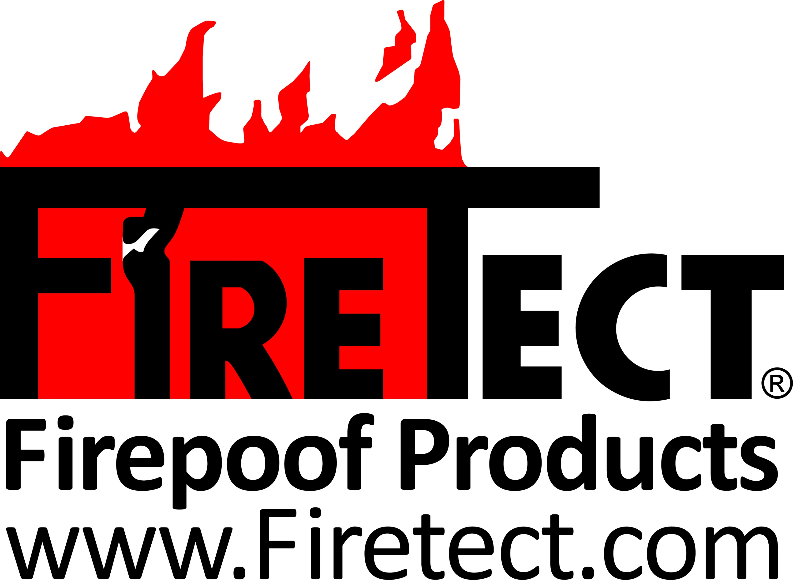
Flame-Retardant Industry Request for Fire Code Support 01/2024
Presented by Kathleen Newman & Cori Leffler

Slide 2
FLAME-RETARDANT INDUSTRY NEEDS SUPPORT
This is a call to become more active with Fire Code Rules and Regulations
International Code Council (IBC, IFC)
NFPA*
ICC*
UL*
FM*
ASTM*
NIST*
WUI*
FLAME-RETARDANT COATINGS PASS THE SAME FIRE TESTS USING THE SAME LABORATORIES THAT THE PRESSURE TREATED WOOD INDUSTRY USES, HOWEVER, THEY HAVE CONVINCED THE PUBLIC AND CODE OFFICIALS THAT THEIR PRODUCTS AND TREATMENT IS SUPPERIOR TO FLAME-RETARDANT COATINGS.
FOR WOOD FLAME-RETARDANTS: Code Officials have made pressure treated wood the preferred method, even though the testing standards are identical.
*May need membership to these organizations so that you can vote on code changes.

Slide 3
History Of Pressure Treated Wood NFPA 703, NFPA 101 & NFPA 5000
1957
It is decided that a standard is needed for Wood.
See NFPA.ORG/703, Origin and Development of NFPA 703 in any edition.
For 27 years Fire-retardant coating and Fire-retardant Treated Wood both are required to meet same standards and are both widely accepted to protect property and life safety.
2006
In 2009, Hoover Treated Wood Industries are appointed onto the NFPA 703 Committee.
2018
Hoover treated wood makes a Public Comment to remove the ability of Fire-retardant Coatings being field applied and to remove the words, “By other means during Manufacture”. Kathy Newman Firetect notifies all Flame-Retardant Companies for help. Only 1 company responded. She submits a NITMAM to allow the words “by other means during mfr” to remain. The motion passes.
Manny Muniz is Hoover Treated Wood Consultant.
2012
Numerous Public Inputs and Comments are made to address the issues within the flame-retardant coatings industry, but faced opposition from the Pressure treated wood industry
1961
NFPA 703- First Edition is Titled, “Fire-Retardant Treatment of Building Materials. This edition includes both Fire-Retardant Coatings and Fire-Retardant Treated Wood to BOTH be tested in accordance with NFPA 255 and held to the same standards.
Edition is Titled, “Fire-Retardant Impregnated Wood and Fire-Retardant Coatings for Building Materials. References two methods; “Fire-Retardant Impregnated Wood” and “Fire-Retardant Coatings”. Both requires NFPA 255
1979-2006
1979
Title of Standard was changed to, “Standard for Fire-Retardant Treated Wood and Fire Retardant Coatings for Building Materials”. TITLE WAS CHANGED FROM, “IMPREGNATED TO TREATED”. THIS IS A PROBLEM BECAUSE ALL WOOD THAT IS ALTERED IS TREATED.
NFPA PUBLICATIONS BY YEAR: 1957, 1961, 1979, 1985, 1992, 1995, 2000, 2006, 2009, 2012, 2015, 2018
Notes:
In 2006, Bill Towson of Arch Treated Wood made a lot of changes to, “by other means” vs. Pressure impregnated.

Slide 4
NFPA 703
Go to NFPA.org/703 →Next Edition→First Draft Report→
Chapter 3, Sec 3.3.2 Definition needs to be verified based on testing review
Chapter 4 Sec. 4.1.2.2.2
See Annex A, Explanatory Material 4.1.1
For previous Editions, you can see who made comments and changed code. Ref: 2015 Edition; Ch 4.1.1.6 This is where Hoover was trying to remove the term, “By Other Means”. In 2018 Edition, “By Other Means During Manufacture” they tried to eliminate it completely. Fortunately, they have not been successful, but if these codes are not monitored, the potential for these changes being made are great if the flame-retardant industry is not paying attention.
NFPA PUBLICATIONS BY YEAR (every 3-5): 1957, 1961, 1979, 1985, 1992, 1995, 2000, 2006, 2009, 2012, 2015, 2018

Slide 5
Code History: In -2003, NFPA 5000, 10.3.1.3 eliminates the ability for Fire-Retardant Coatings to be used for interior finishes. Reason for this was NFPA’s take was the fire-retardant coatings are not allowed to be used for design or construction. See 1.2 With 2015 Edition, in section 10.4.1.3, continues to state that fire-retardant coatings shall not be used to comply with this code. Sec. 10.4.1.4, was added “factory-applied fire-retardant-coated products shall be permitted that have been listed and labeled to comply with ASTM E2768” No ability to apply flame-retardant coatings in the field is allowed. This also negates the ability for the flame-retardant surface to be maintained. This eliminates for the potential of flame-retardant coatings to be used, even in the future. Quality control can be mitigated by allowing Certified Applicators, or Licensed Professional to certify the application in the field. As long as a product complies with a fire code, why does NFPA dis-allow other processes to be prohibited?
NFPA 5000-24 INTERIOR FINISH CODES THAT COMMENTS ARE RECOMMENDED
Go to NFPA.org/5000 →Next Edition→First Draft Report→ You can also see current Editions
Chapter 3, Sec 3.3.241 Definition of Fire-Retardant Coatings does not exist. FRTW is defined.
See Section 10.2.3.6.1; Fire-Retardant Coatings SHALL NOT be used to obtain compliance with the interior finish requirements of this code.
10.2.3.6 Throughout this code, Fire-Retardant Treated Wood is permitted if it has hourly ratings. There are flame-retardant coatings on the market that comply with hourly ratings and should not be prohibited nor should the ability to invent them.
Chapter 45.2.8 Definition of Fire-Retardant Coatings does not exist. FRTW is defined.
NFPA PUBLICATIONS ARE REVISED: (every 3-5 years): 1957, 1961, 1979, 1985, 1992, 1995, 2000, 2006, 2009, 2012, 2015, 2018, 2024

Slide 6
NFPA 101-21 LIFE SAFETY CODE
Go to NFPA.org/101→Next Edition→First Draft Report→
Sec 3.3.112 Definition of Fire-Retardant Coatings Was Added
Sec 4.6.16 Definition of Fire-Retardant Coatings does not exist. FRTW is defined.
Sec 4.6.16.2 defines, “Other Means” as pressure treated wood
10.2.6 Fire-Retardant Coatings information. Please read this section. Needs to be discussed with flame-retardant interests.
NFPA PUBLICATIONS BY YEAR (every 3-5): 1957, 1961, 1979, 1985, 1992, 1995, 2000, 2006, 2009, 2012, 2015, 2018, 2021, 2024

Slide 7
ISSUES, CONCERNS
The Pressure Treated Wood Industry has now eliminated Flame-Retardant Coatings from being used for interior finish. Even though Fire-Retardant Coatings pass the same fire code tests by Certified, Independent Laboratories as the Pressure Treated Wood Industry does, the fire codes are different from the process of how the fire codes are achieved.
PLEASE BECOME MORE ACTIVE IN ALL ORGANIZATIONS LISTED ON SLIDE 2. SPECIAL INTEREST ORGANIZATIONS HAVE HIRED CONSULTANTS TO SPEAK FOR THEM AND OVERSEE FIRE CODES THAT MAY BENEFIT THEIR INDUSTRY.
THE FLAME-RETARDANT INDUSTRY HAS NO REPRESENTATION TO PREVENT THIS FROM HAPPENING. EVEN THE ABILITY TO COME UP WITH NEW INVENTIONS HAVE BEEN TAKEN AWAY.
THE FLAME-RETARDANT INDUSTRY NEEDS YOUR COMMITMENT AND YOUR VOICE TO BE HEARD DURING THE PUBLIC COMMENT PHASES FOR THE CODES IN QUESTION. WE ALSO NEED SPEAKERS DURING THE CODE MAKING PROCESS.
PLEASE LET ME KNOW IF YOU ARE ABLE TO SUPPORT OUR INDUSTRY. I WILL KEEP YOU INFORMED AS MUCH AS I CAN, BUT I CANNOT EXPRESS THE HIGH IMPORTANCE OF THE FLAME-RETARDANT COATINGS INDUSTRY TO BECOME MORE INVOLVED.

Slide 8
FRTW
Myth VS. Fact

Slide 9
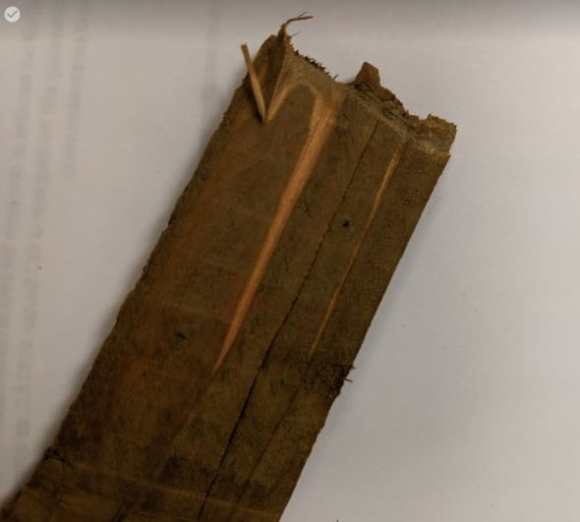
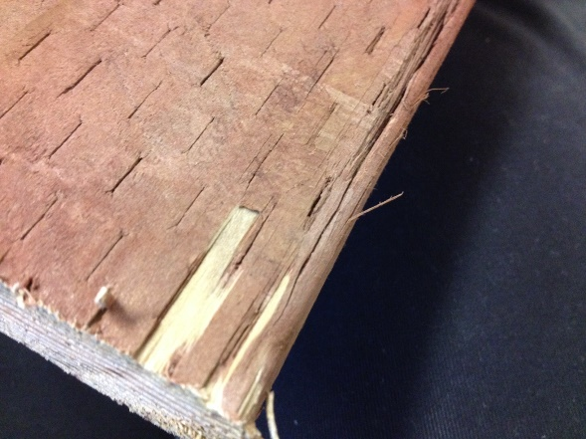
MYTH: Pressure Treated Wood is flame-retardant throughout the middle and entire piece of wood.
FACT: There are no published tests that exist that proves that Pressure Treated Wood penetrates deep inside and throughout the wood. In fact, Pressure Treated Coatings are a topical treatment, the same as Flame-Retardant Coatings are. The pictures show the pressure treatment to the surface of the wood only.
FACT: ASTM E84 only assesses surface burning characteristics
FACT” AC66 (FRTW) recognizes that penetration may not be complete. “6.5 The fire-retardant-treated lumber shall not be ripped or milled as this will alter the surface-burning characteristics and invalidate the flame-spread classification”.

Slide 10
Do a search on the internet and type in, “pressure+treated+wood+peel” and then click on, “Images”. Pressure-treated wood is degradable
MYTH: Pressure Treated Wood is more durable than Fire-Retardant Coatings.
FACT: Both Pressure Treated Wood and Fire-Retardant Coatings must specify for interior use only or if being installed exterior, must have been tested by a Certified Independent Laboratory for exterior weather testing and must also indicate approval for exterior use. The fire code should not deviate or favor one industry over the other; fire code compliance is the goal.

Slide 11
Extended 30 Minute Burn Test, ASTM E 2768
FRTW claims that there are no flame-retardant coatings on the market that can comply with this code. Currently there are. Why limit the ability for other products on the market to comply? Limiting options adds costs to the end user and prevents new products from coming out on the market.
MYTH: Only Pressure Treated Wood can comply with ASTM E2768, Extended 30 Minute Burn Test.
FACT: There currently are topically flame-retardant applied coatings on the market now that comply with this same code. https://flameseal.com/flame-seal-84-fireproof-paint/ https://frctexas.com/content/documentation/01%20FX%20Lum%20Grd%20TDS%202-25-19.pdf

Slide 12
Keeping Options Open For The Consumer.
Coatings can be applied on or off-site by experienced painters, but pressure treated wood cannot. ALL pressure treated wood and flame-retardant coatings must be, “Maintained”; If the topical treatment of the pressure treated wood is damaged or becomes exposed, just like the pictures above, how is one supposed to be able to maintain protection? The only answer is to add a properly rated fire-retardant product to the exposed surfaces of the wood or remove the installation and re-fabricate.
Pressure Treated Wood is very difficult to work with, it warps, chips and is corrosive to metal and strength integrity has been proven to be compromised.
Again, all Fire Codes must be tested in the same exact way, using the same exact methods to comply with required fire codes. Application of treatments should not be stipulated if the fire code has been met. The way that the fire codes currently read prevents any other product from being used that currently complies with the same fire codes and also prevents any product from being used after development.
A single industry should not be allowed to shape the entire narrative.

Slide 13
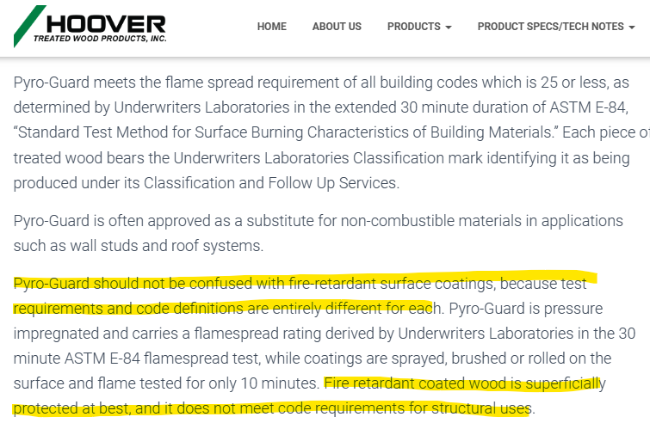
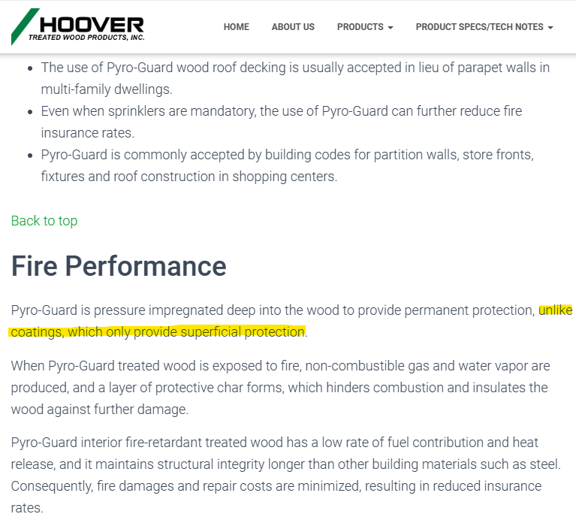
This is a recent example of the information being published by the pressure treated wood industry:
https://frtw.com/?page_id=57

Slide 14
THE FLAME-RETARDANT INDUSTRY NEEDS REGULATORY SURVAYLANCE
The term, “Fire-Retardant Coatings” has been used in the NFPA Code since 1957. In 1989, the pressure treated wood industry developed. Today, FRTW and code officials have allowed to almost eliminate the use of flame-retardant coatings.
Flame-retardants on the market are tested by Independent, Certified Laboratories using the exact same testing as Fire-Retardant- Treated wood. No industry should be eliminated from being able to comply with the fire codes and limit consumer options.
The Flame-Retardant Coating Industry has not been involved in these changes and our industry needs support. If we don’t pay attention and make comments on these changes, the flame-retardant coatings industry will continue the inability for consumers to have options to comply with fire codes.

Slide 15
Time is of the essence. Public comments close on 06/04/2024 for the 2027 Edition! After that date, the opportunity to submit any changes will not come up again for another 3 years, and would not be printed until 2030! Please be specific with NFPA Codes when submitting a comment. Attach testing examples, ideas, solutions. Flame-Retardant Coatings can and do comply with the same standards as Pressure Treated Wood!
If you are not registered with www.nfpa.org
Go to
https://www.nfpa.org/codes-and-standards/7/0/3/703?l=68
Click on Current and Prior Editions, Scroll down and click on Free Access and register.
After you register, click on, “Next Edition” and click on, “Submit Public Input Online”.
Feel free to email to call me if you have any questions.
Kathy@firetect.com 661.295.3473

