Slide 1
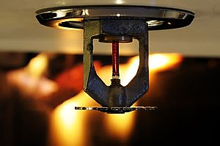
AUTOMATIC FIRE EXTINGUISHING SYSTEMS CERTIFICATION
OFFICE OF THE
STATE FIRE MARSHAL
FIRE SPRINKLER FITTER

Slide 2
BACKGROUND
Health and Safety Code Section 13110 authorizes the State Fire Marshal to propose, adopt, and administer the regulations he/she deems necessary to ensure fire safety in buildings and structures within the state.
Due to the increasing use of fire protection systems throughout the state, changes in construction standards, and the increased complexity of fire protection systems, the regulations were developed to ensure that those who install water-based fire protection systems possess the necessary skills, experience, and qualifications to safely do so.
The regulations were developed by a workgroup consisting of representatives from industry, labor, enforcing agencies, and CAL FIRE – Office of the State Fire Marshal (CAL FIRE – OSFM) staff and were approved by the State Fire Marshal’s Automatic Extinguishing Systems Advisory Committee.
Phase I – Installation; Phase II – Testing & Maintenance; Phase III – Engineered and Pre-Engineered Specialty Systems

Slide 3
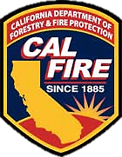
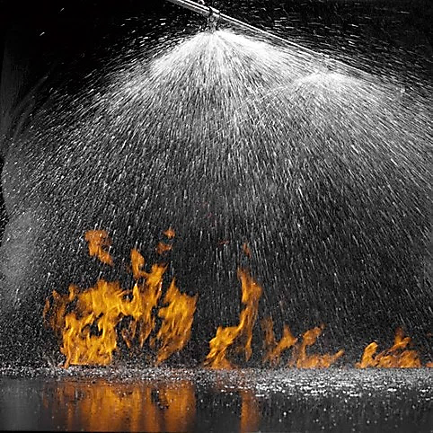
WORK COVERED
Work consisting of the installation, alteration or repair of water-based fire protection systems.
Wet, dry, pre-action, and deluge sprinkler systems, including small hose connections, standpipe systems, private fire service mains and their appurtenances (hydrants and monitor nozzles), water spray systems, foam water systems, fire pumps, water storage tanks, low, medium, and high expansion foam systems, and water mist systems.
Commercial and residential occupancies with three (3) or more dwelling units up to, and including, four (4) stories in height.

Slide 4
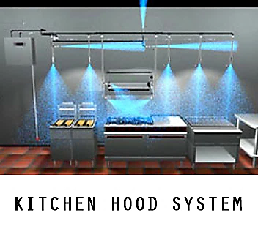
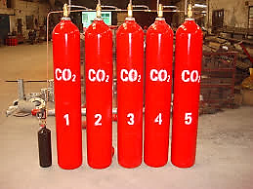
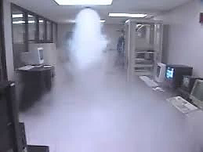
WORK EXCLUDED
One and two-family residential sprinkler systems.
Installation, alteration or repair of underground water supply lines from the connection of the water supply to the first joint, or mechanical connection at the base of the system riser.
Installation of engineered and pre-engineered specialty systems.
Pre-engineered fixed systems are systems where the number of components and their configurations are included in the description of the systems approval and listing.

Slide 5
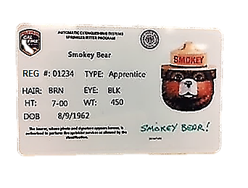
IMPLEMENTATION PERIOD
July 1, 2017 – Regulations become effective.
December 31, 2017 – Deadline for Journeyman Fire Sprinkler Fitters, those who possess an active C-16, or those employed by a C-16 who meet the minimum qualifications to certify without taking the certification examination.
July 1, 2018 – Certification card required for fitters; requires at least one certified fitter per job site.
January 1, 2019 – All fitters shall possess a certification card, all trainees and apprentices shall possess a registration card.

Slide 6
TIMELINE
July 1, 2018
At least one certified sprinkler fitter on each job site.
December 31, 2017
Deadline to become certified without taking an exam.
January 1, 2019
All fitters on job site certified.
All trainees and apprentices on job
site registered.
July 1, 2017
Regulations are effective.
No certification card required until July 1, 2018.
2017
2018
2019
Notes:
Add your own dates and event details to the flag markers. Move the flags along the timeline to match your event dates. Copy and paste a flag to add more.

Slide 7
FIRE SPRINKLER FITTER CERTIFICATION
Prior to January 1, 2018:
Be at least 16 years old.
Journeyman Fire Sprinkler Fitter, active C-16 holder, or those who meet the minimum qualifications below:
Commercial – 7,000 hours and five years verified work experience.
Multi-family residential – 3,500 hours and two years verified work experience.
Employment experience and hours shall be provided in a letter(s), on company letterhead, from the applicant’s current and/or former employer(s) certifying, under penalty of perjury, the applicant’s experience and hours.
File a Fire Sprinkler Fitter Certification Application (AES 1005), along with documentation of hours and experience, and pay the $150 fee.
No written certification examination required.

Slide 8
FIRE SPRINKLER FITTER CERTIFICATION
After January 1, 2018:
Be at least 16 years old.
Active C-16 holder or have successfully completed a California State or federally-approved Fire Sprinkler Fitter Apprenticeship Program.
File a Fire Sprinkler Fitter Certification Application (AES 1005), along with documentation of hours and experience, and pay the $150 fee.
Pass a written certification examination.

Slide 9
SPRINKLER FITTER CERTIFICATION APPLICATION

Slide 10
FIRE SPRINKLER FITTER APPRENTICE REGISTRATION
Be at least 16 years old.
Registered in a State of California or federally-approved Fire Sprinkler Fitter Apprenticeship Program.
Proof of employment by a licensed C-16.
Work under the direct supervision of a Certified Fire Sprinkler Fitter.
File an Apprentice/Trainee Registration Application (AES 1005A), along with proof of acceptance into a State of California or federally-approved fire sprinkler fitter apprenticeship program, and pay the $150 fee.

Slide 11
FIRE SPRINKLER FITTER TRAINEE REGISTRATION
A person not registered in a California State or federally-approved Fire Sprinkler Fitter Apprenticeship Program shall be registered as a trainee and may work as a trainee for up to one year.
Be at least 16 years old.
Proof of employment by a licensed C-16.
Work under the direct supervision of a Certified Fire Sprinkler Fitter.
Be registered into a California State or federally-approved Fire Sprinkler Fitter Apprenticeship Program within one year of their date of hire.
File an Apprentice/Trainee Registration Application (AES 1005A) and pay the $150 fee.

Slide 12
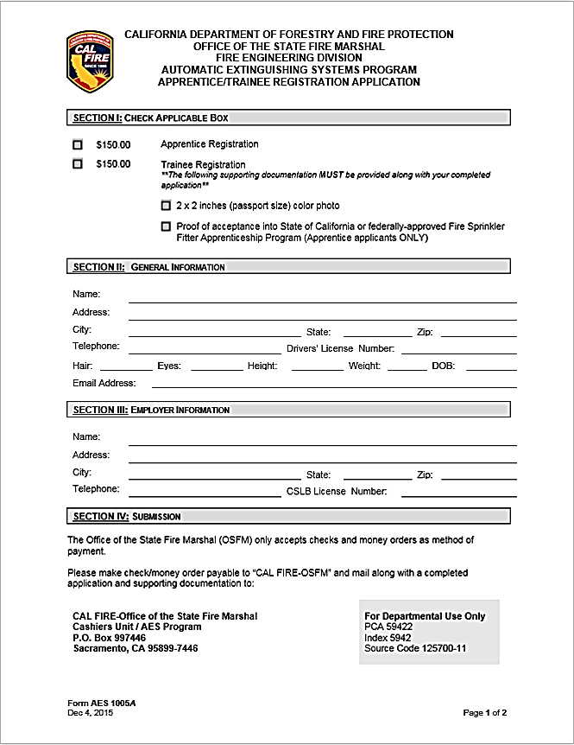
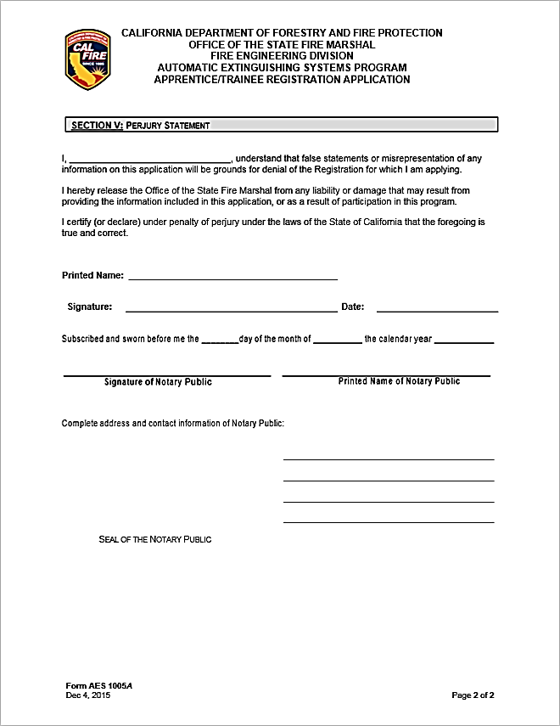
APPRENTICE/TRAINEE REGISTRATION APPLICATION

Slide 13
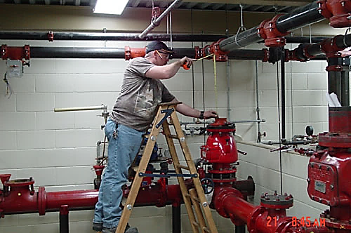
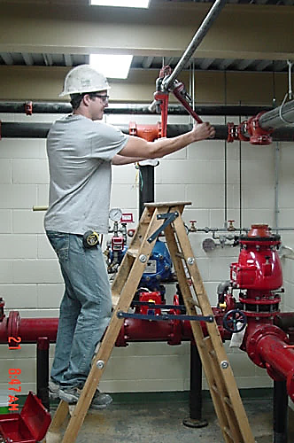
EMPLOYER RESPONSIBILITIES
Ensure all fire sprinkler fitters under their employment are certified or registered.
Must notify CAL FIRE - OSFM in writing within 72 hours from the date of hire of an employee’s status as a trainee, apprentice or certificate holder.

Slide 14
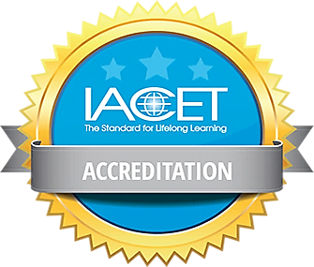
CONTINUING EDUCATION
Certified Fire Sprinkler Fitter shall complete three units of American National Standards Institute/International Association of Continuing Education and Training (ANSI/IACET) accredited continuing education within a three-year period. This requirement is verified by the OSFM every three years at time of renewal.
If proof of completion is not received at time of renewal on the third year of the three-year period, the Certified Fire Sprinkler Fitter shall be required to reapply as a new applicant and pay all associated fees.

Slide 15
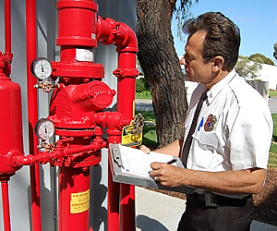
ENFORCEMENT
CAL FIRE - OSFM or AHJ is authorized to inspect worksites and proof of certification or registration card.
Notice of Violation/Correction Order
Stop Work Order
72 hrs
AHJs shall submit written reports to the OSFM for any action taken against Trainees, Apprentices, or Fitters.
Reports may be forwarded to the Division of Apprenticeship Standards (DAS) or the Contractors State License Board (CSLB).
OSFM may revoke or suspend certification or registration cards and deny applications for violations.
Possible civil penalties and/or misdemeanor charges.

Slide 16
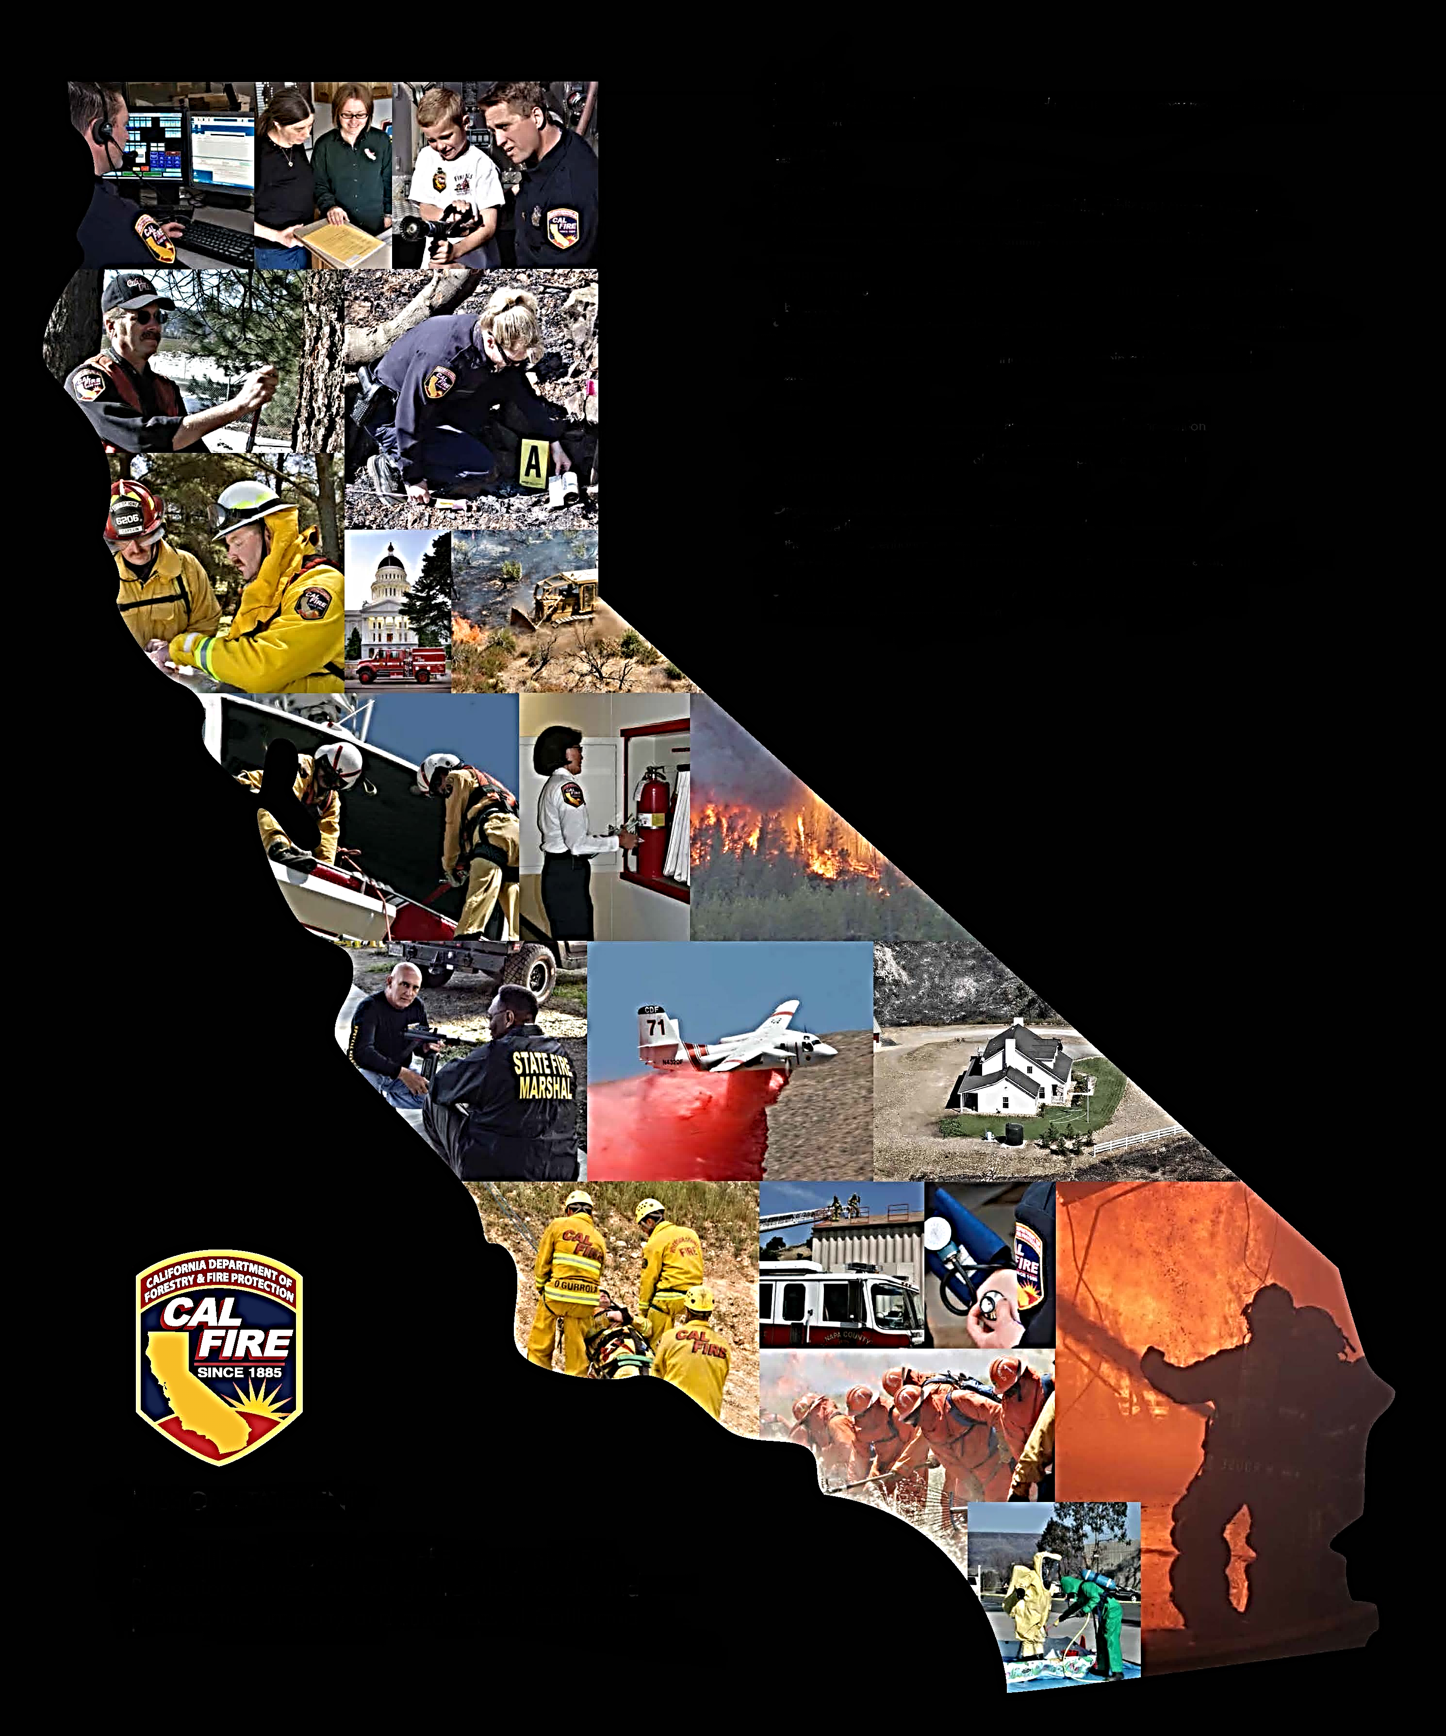
PLEASE NOTE:
The regulations will be effective July 1, 2017.
All applications will be made available on the CAL FIRE – OSFM’s website (www.osfm.fire.ca.gov) and are currently being accepted for filing.
Certification and registration cards will not be issued until the regulations are effective on July 1, 2017.
Additional information is available on the CAL FIRE - OSFM’s website.

Slide 17
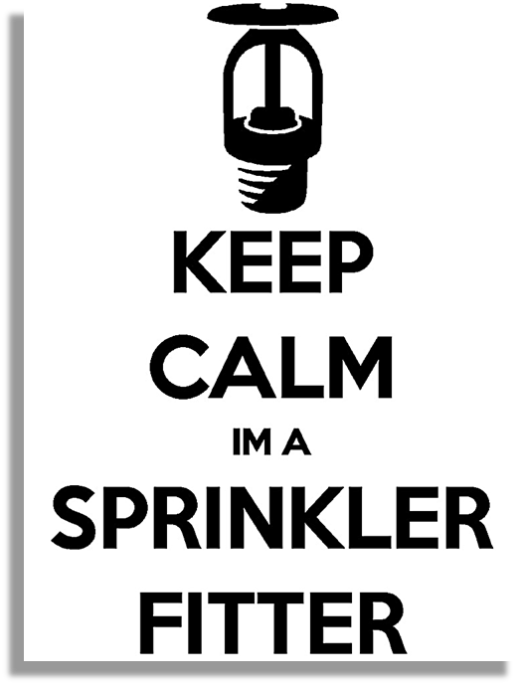
QUESTIONS?

